Slide 1
AIMS Paper Figures

Slide 2
Results Outline
More ELA → lower resilience + higher trait anxiety (supplemental table, refer in text)
Specificity of AIMS to ELA
eBMRQ + ELA: four block figure (AIMS + threat/CHAOS for both studies)
Escapism ~ BMRQ + AIMS subscales (what is abs?)
HUMS ~ absorption + Absorption → resilience (both studies; behaviors consequence of abs)
Mediation model (CHAOS - AIMS – resilience; both studies)
N.s. for just childhood CHAOS
Significant for adolescence CHAOS
CHAOS mediation remained sig w/ age as a covariate (cite music reward decreasing of age/retrospective reporting could be confound)
Add age + musical training / musical sophistication correlations throughout, report mediation w/ age (and then co-vary *when* correlated)

Slide 3
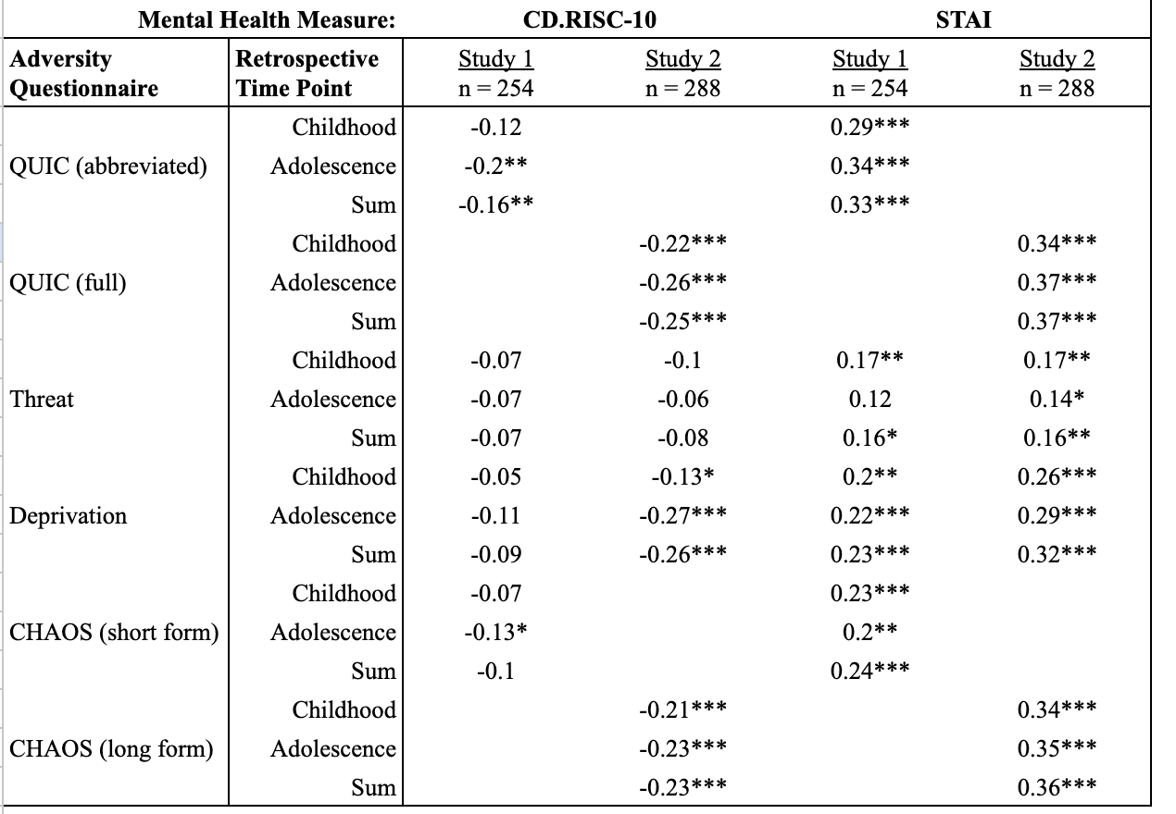
ELA & Mental Health Outcomes Table
Notes:
Double check resilience + ELA variable coding for study 1
UPDATE RHO

Slide 4
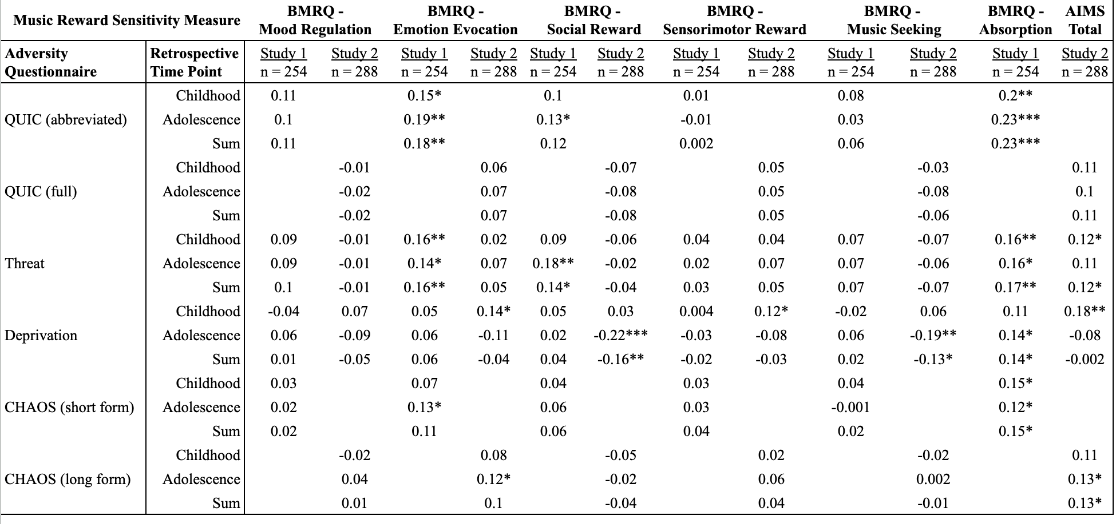
ELA & eBMRQ/AIMS Table
Notes:
UPDATE

Slide 5
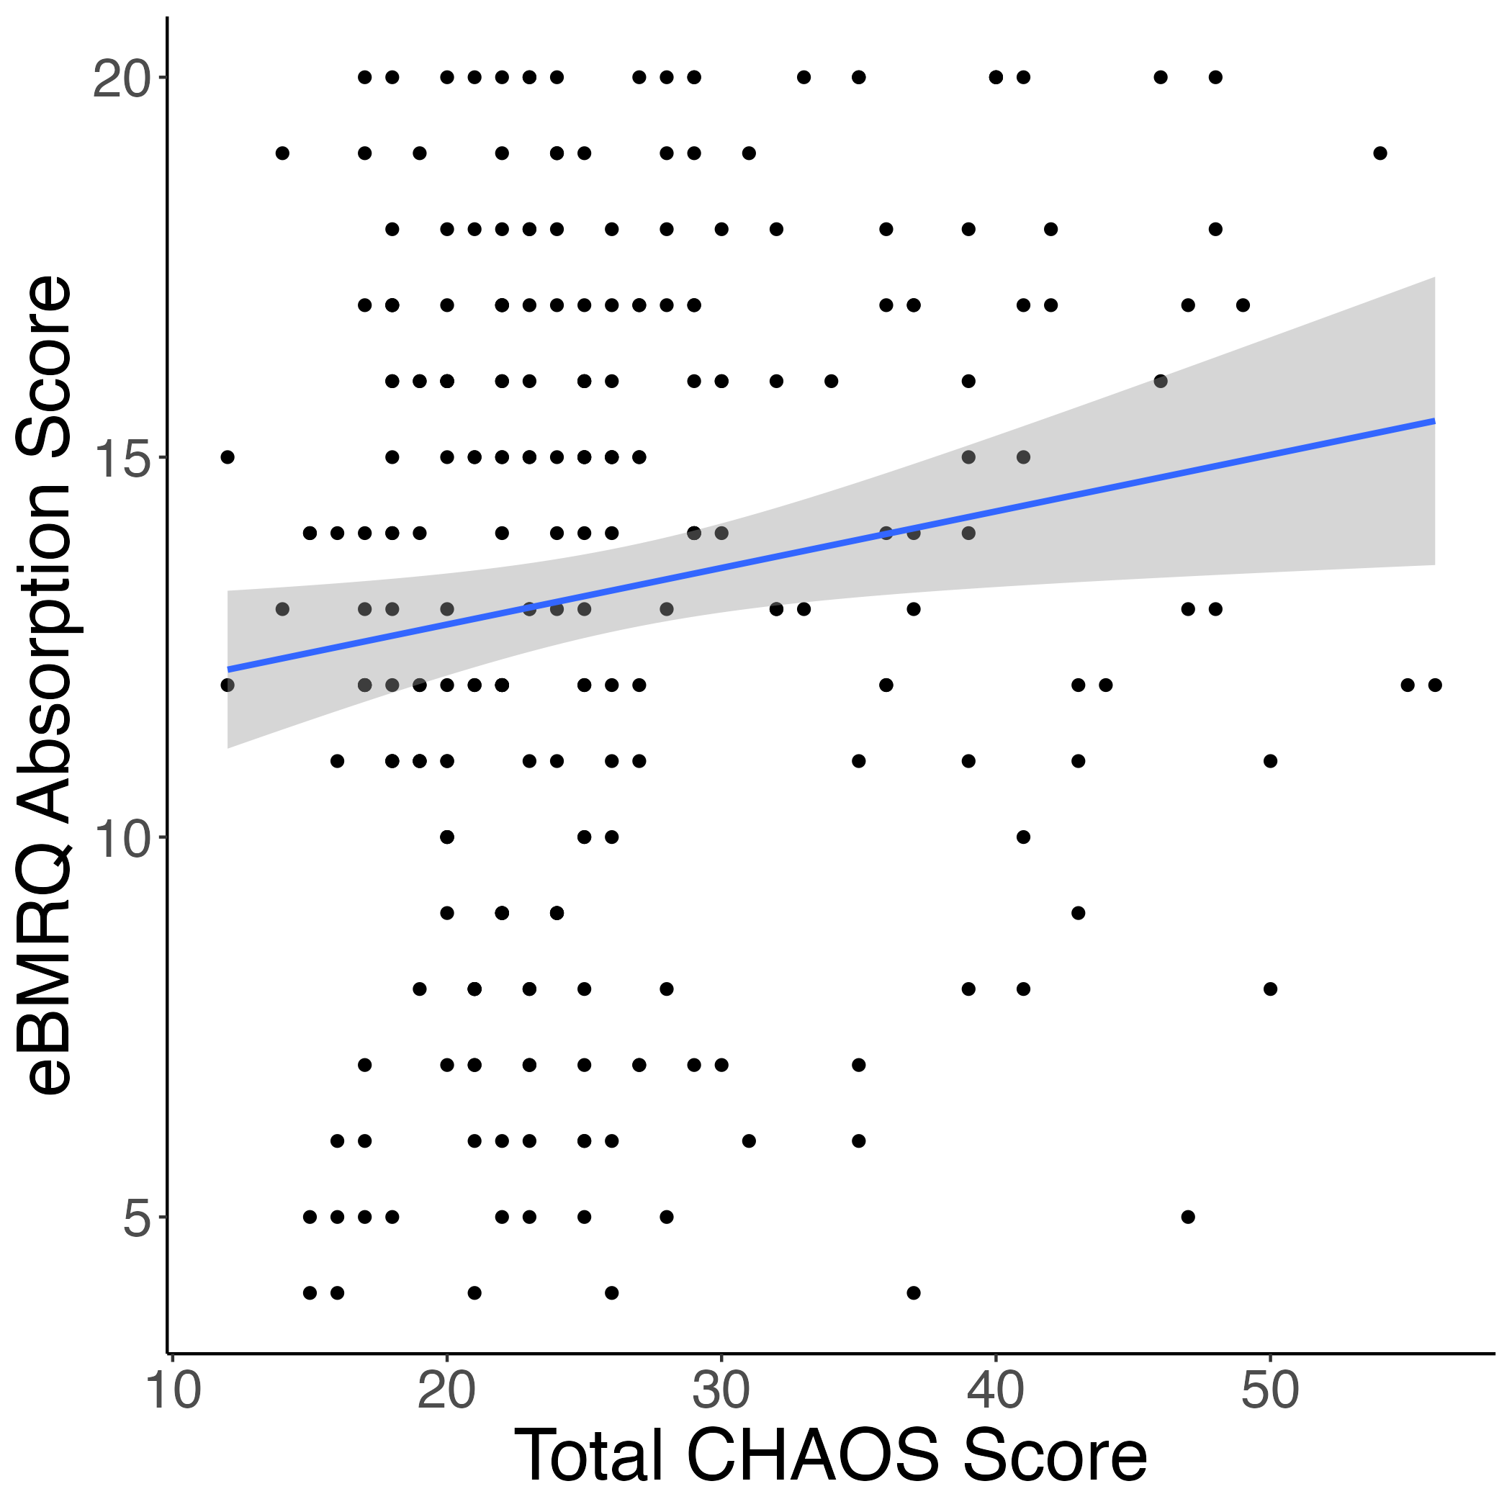
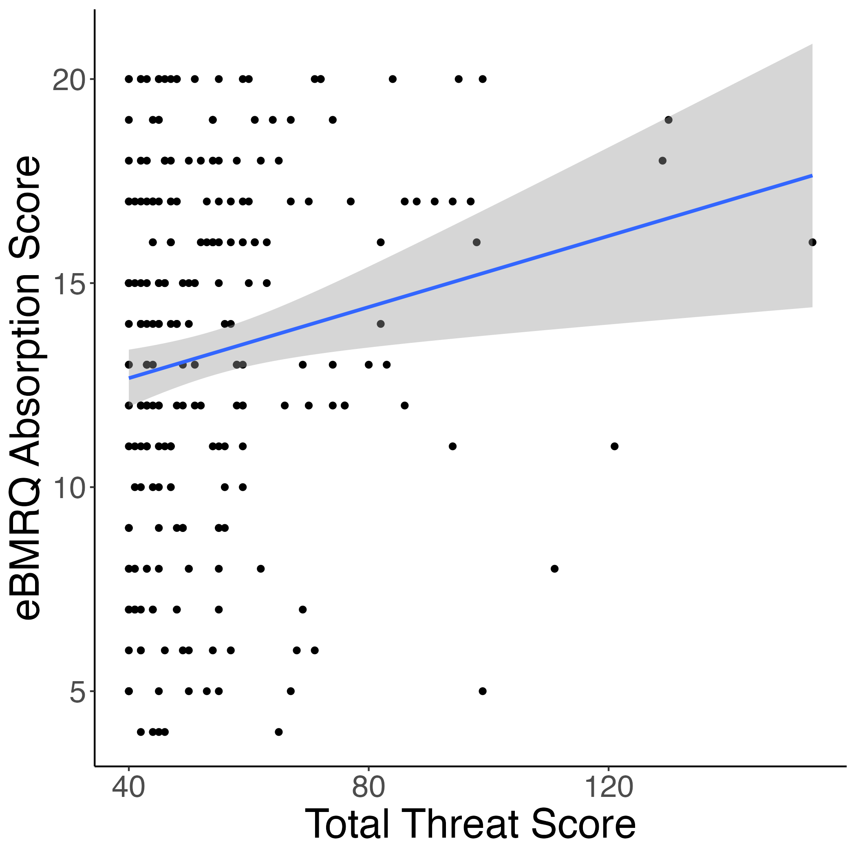
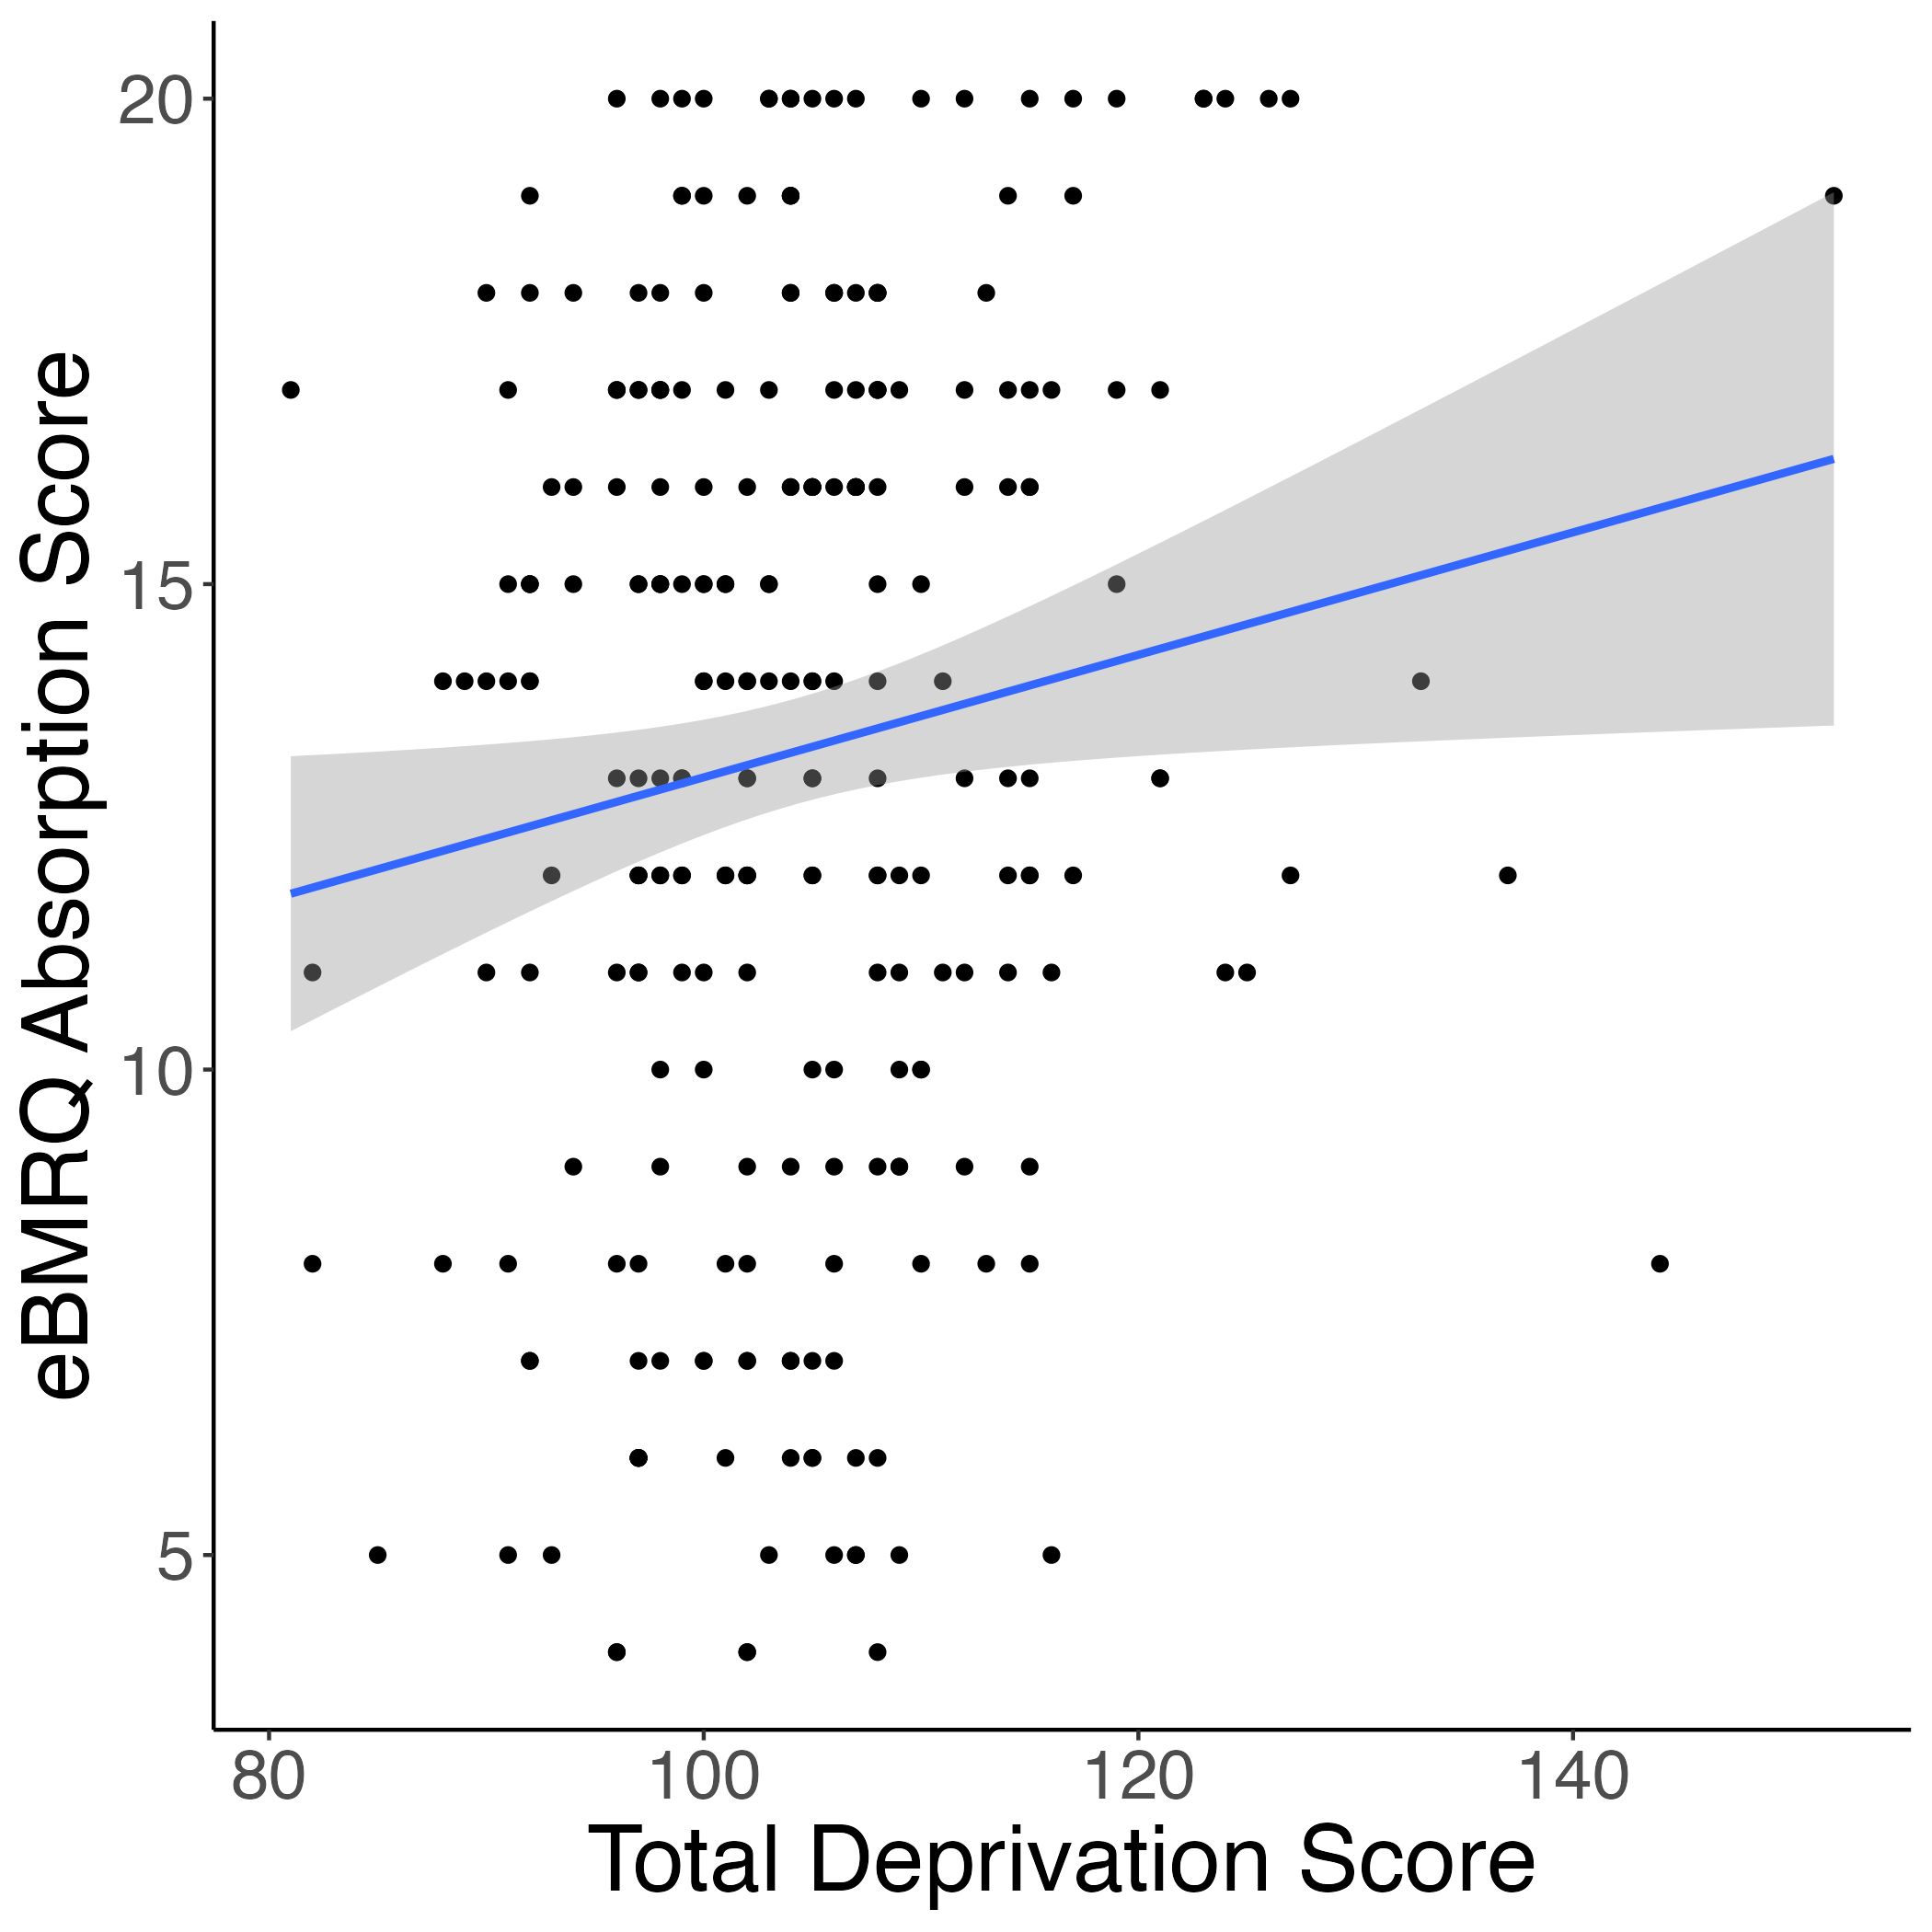
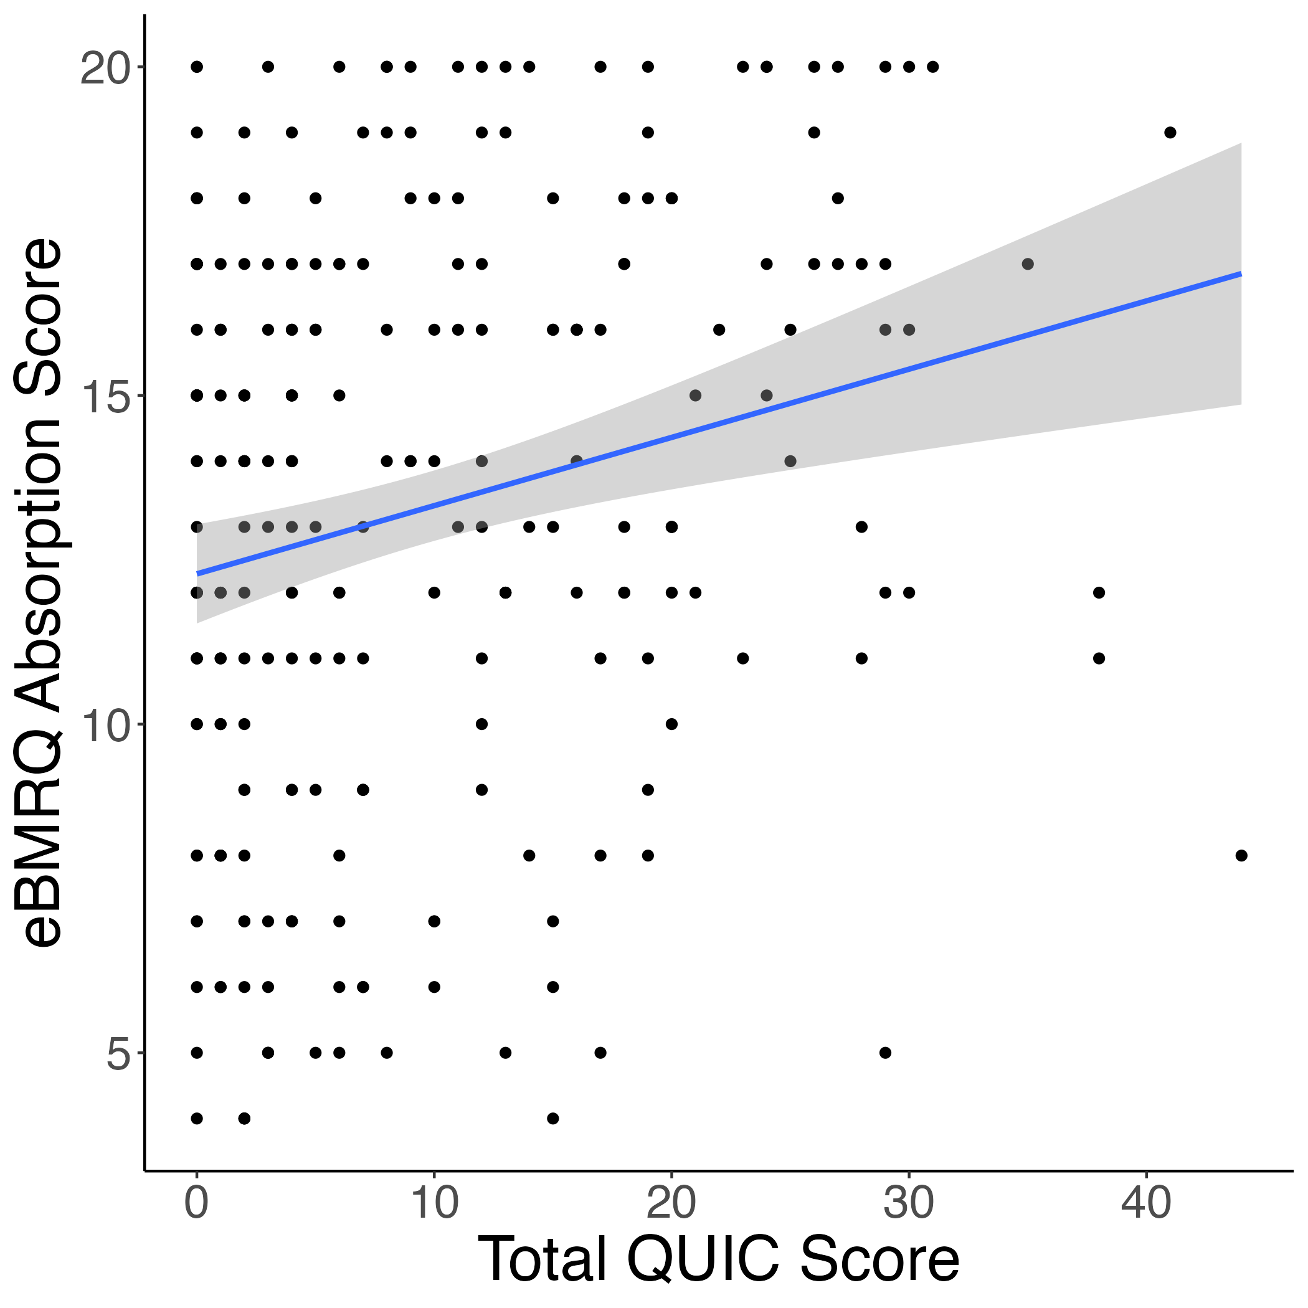
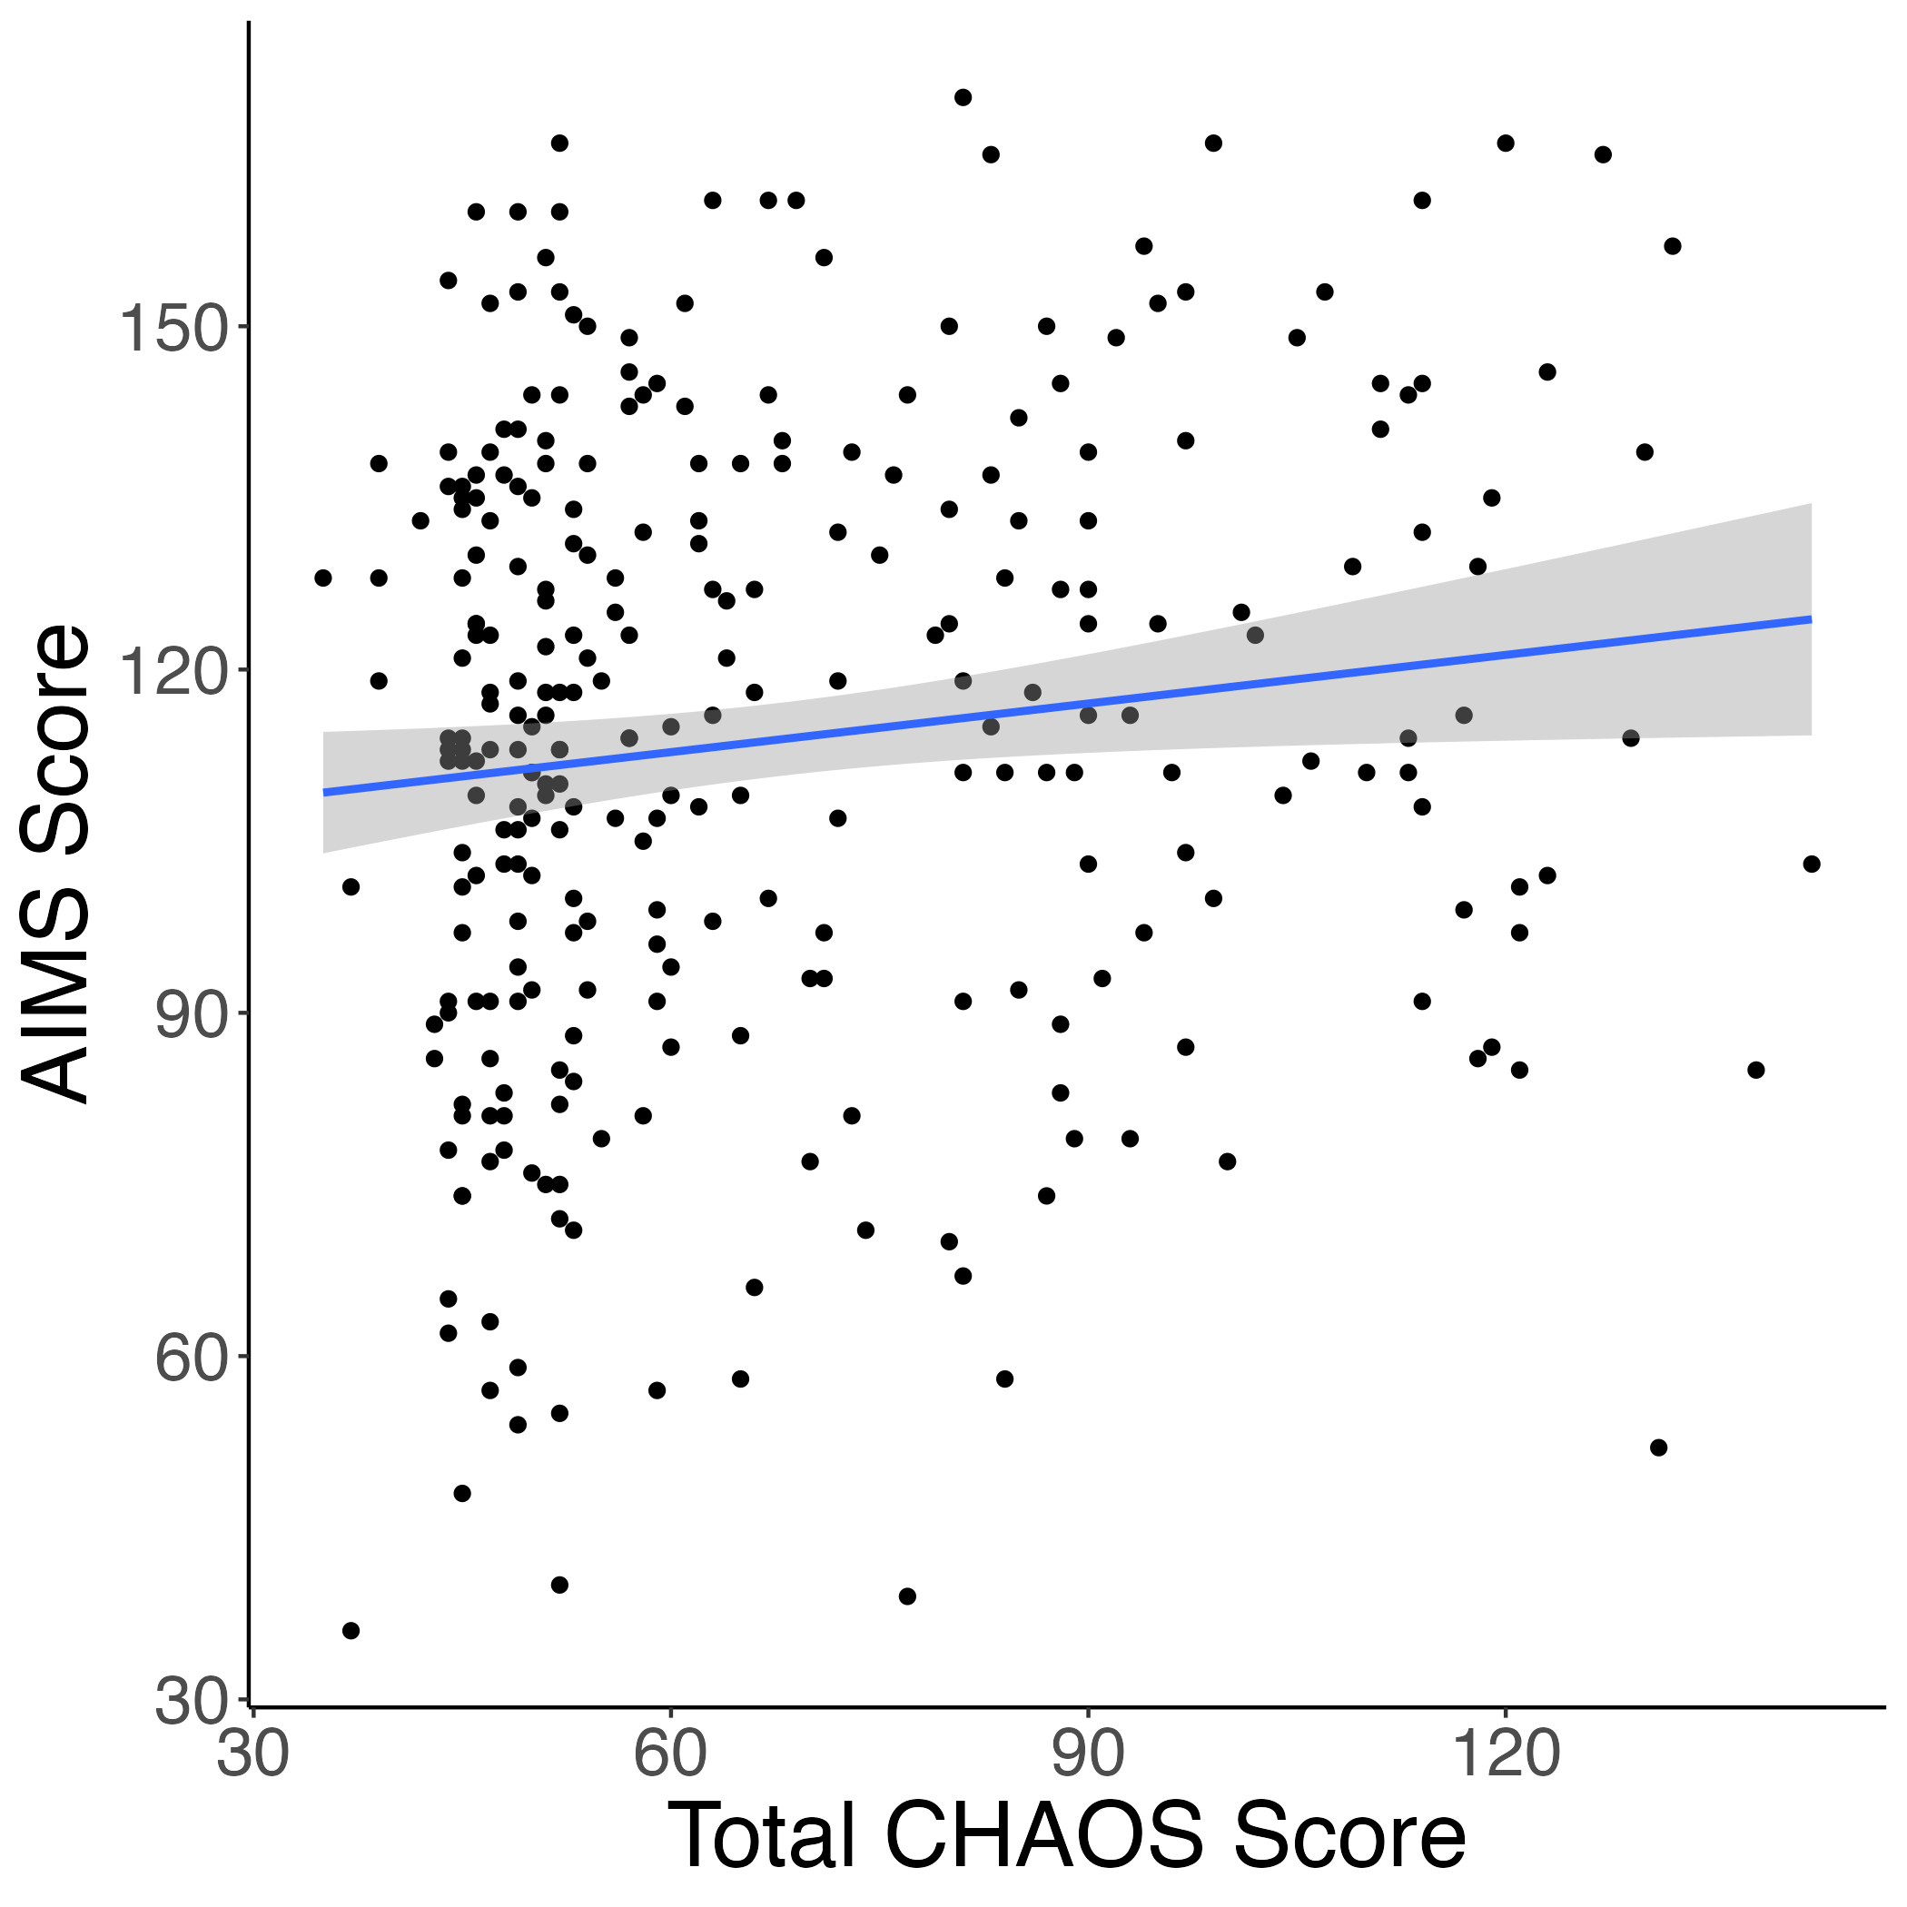
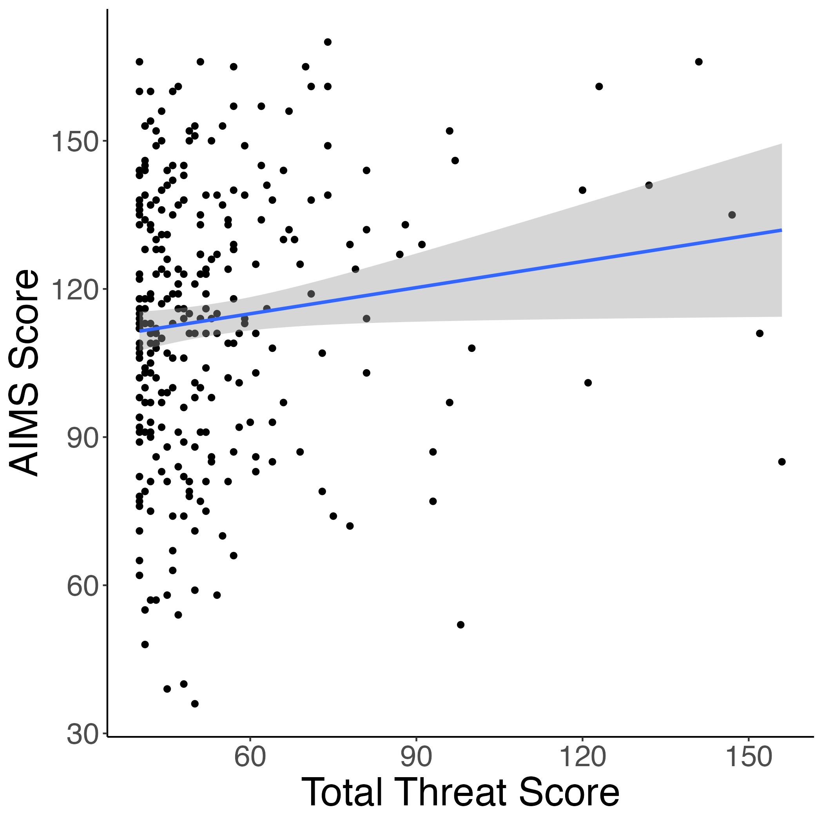
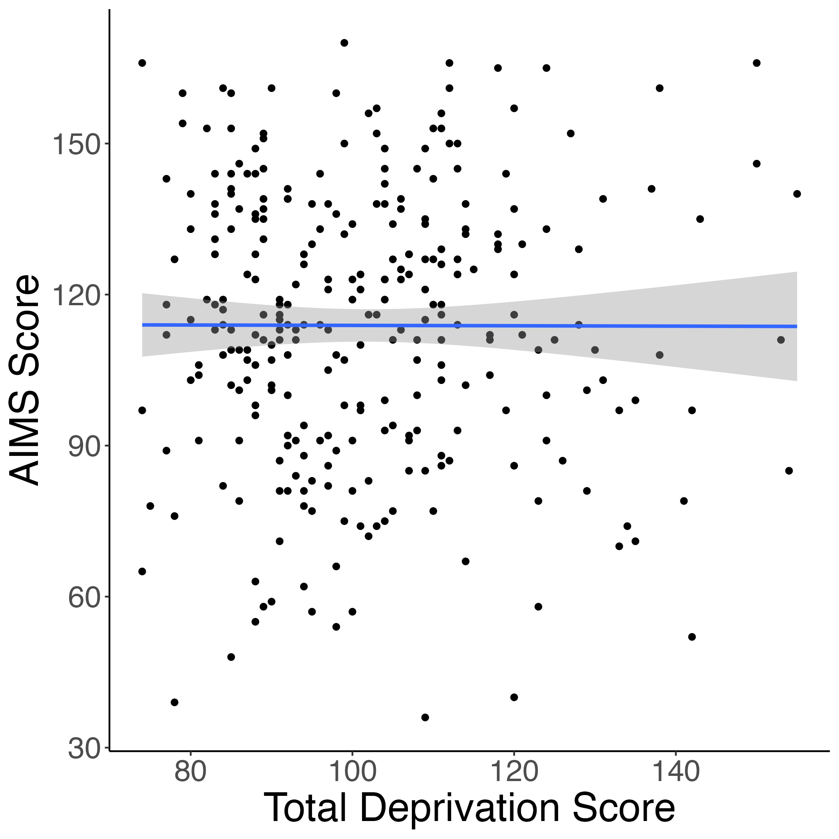
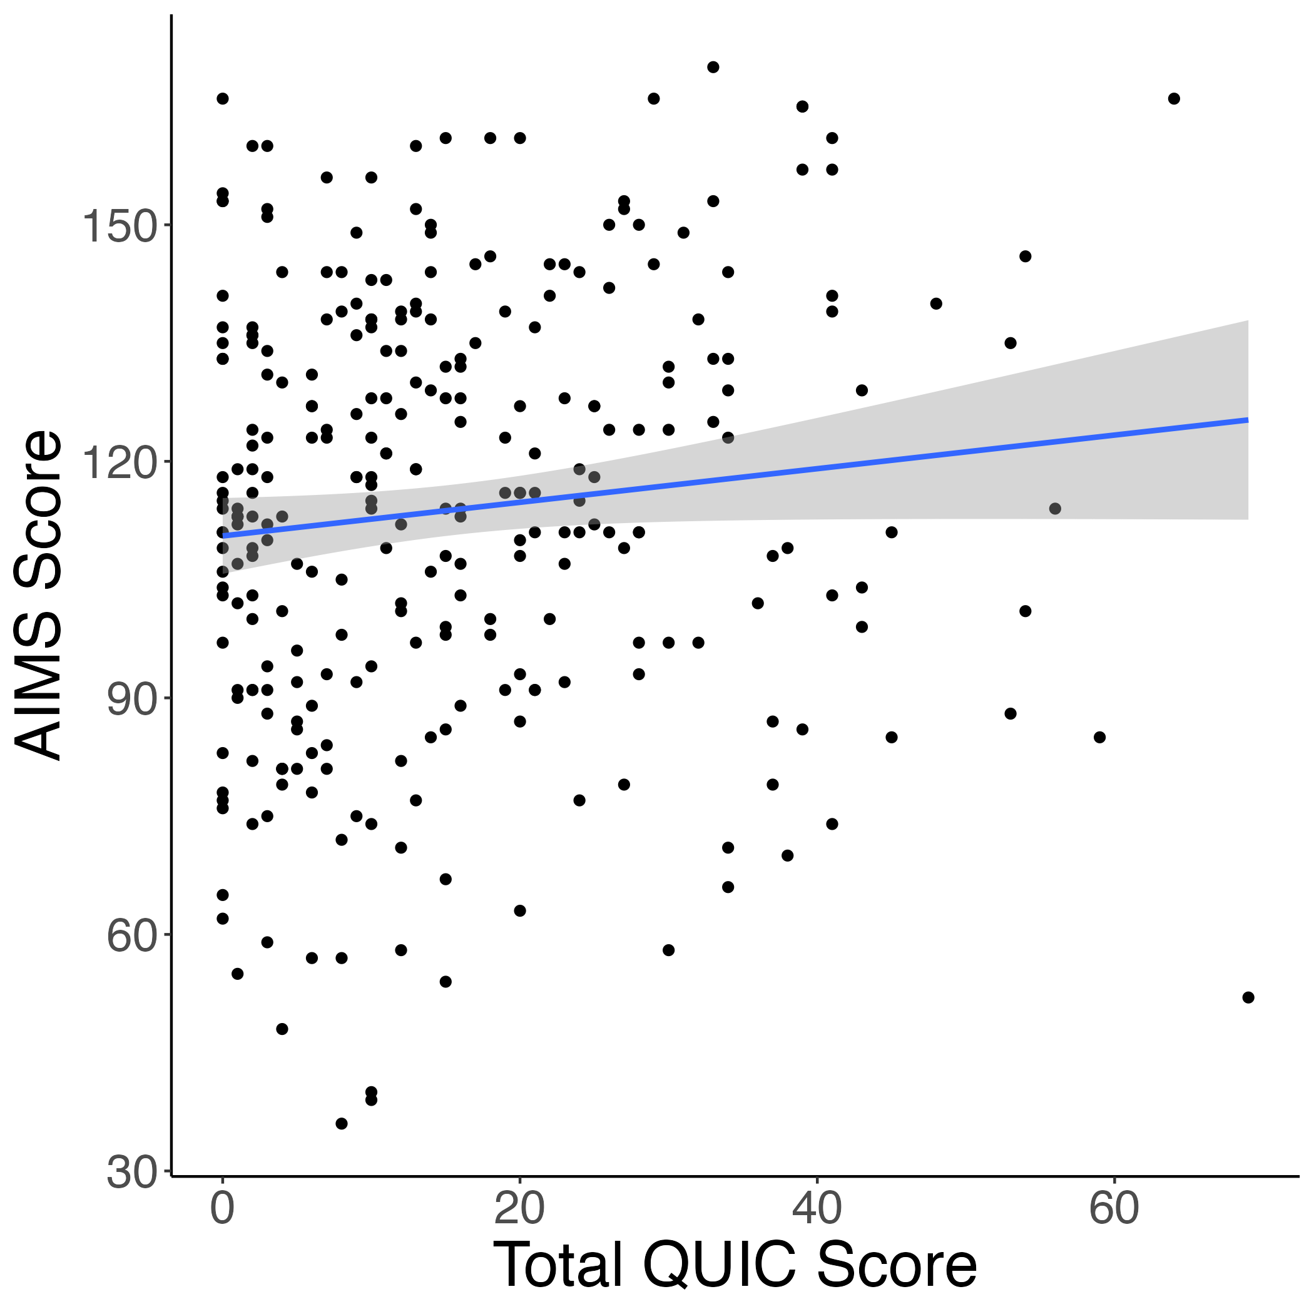
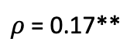
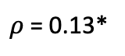
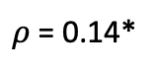
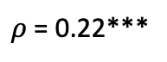
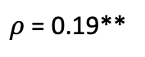
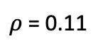
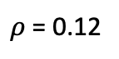
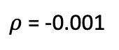
ELA & Absorption Correlations
Study 1
$ρ$ = 0.17**
$ρ$ = 0.19**
$ρ$ = 0.12
$ρ$ = 0.22***
Study 2
$ρ$ = 0.14*
$ρ$ = 0.11
$ρ$ = -0.001
$ρ$ = 0.13*

Slide 6
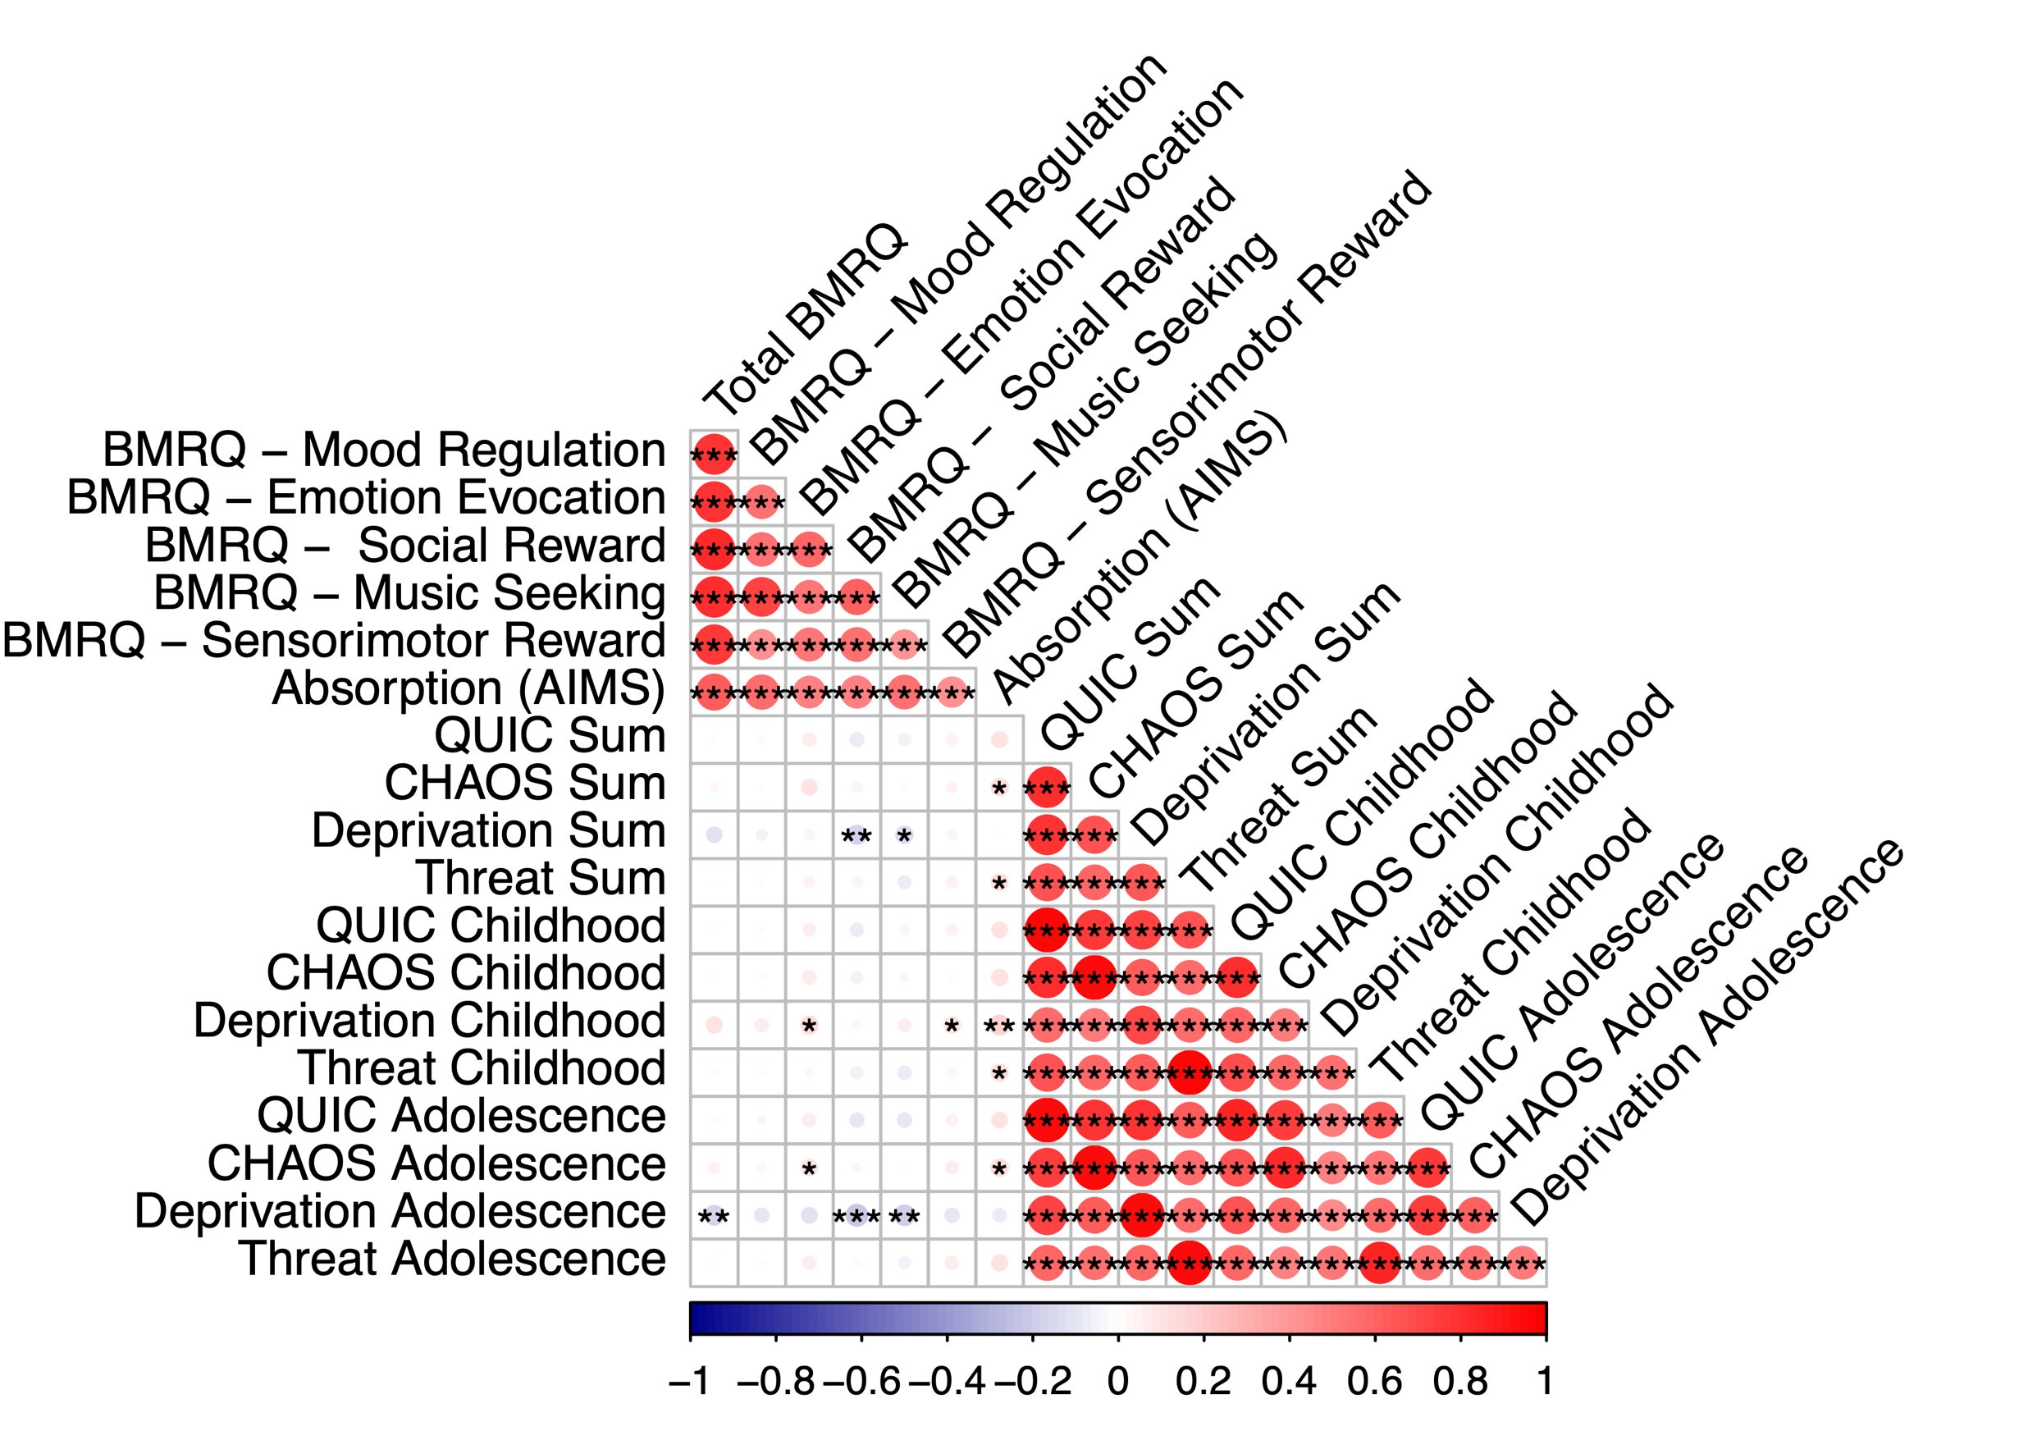
Correlation matrices for ELA + (e)BMRQ & AIMS
Study 1
Study 2
Notes:
Make into table w/ eBMRQ + ELA measures like slide 1 (sep columns eBMRQ/AIMS, but collapsed for other subscales)

Slide 7
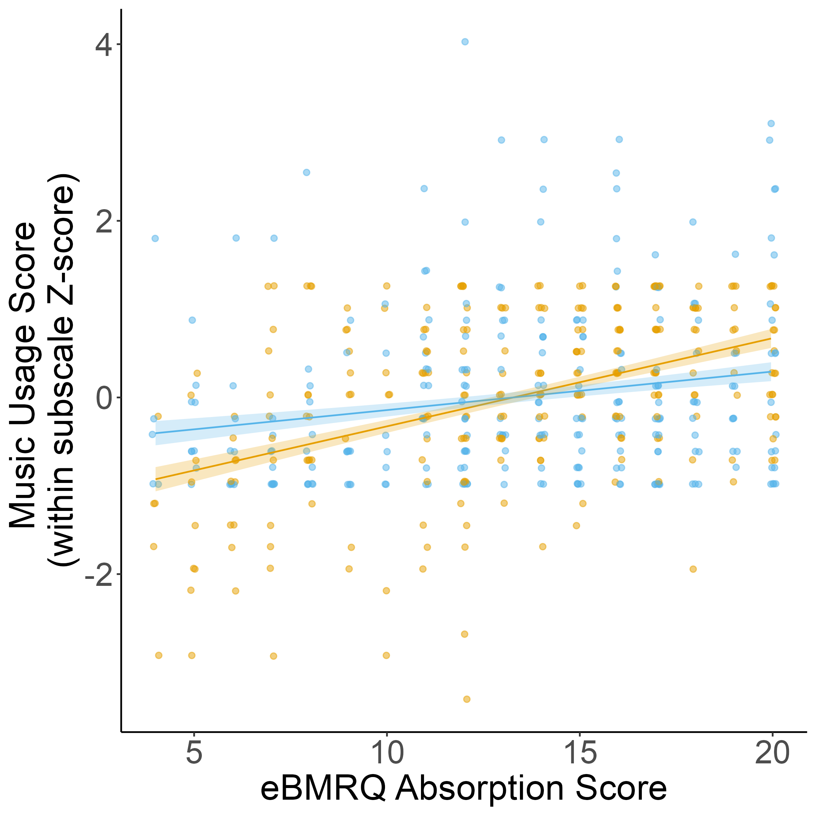
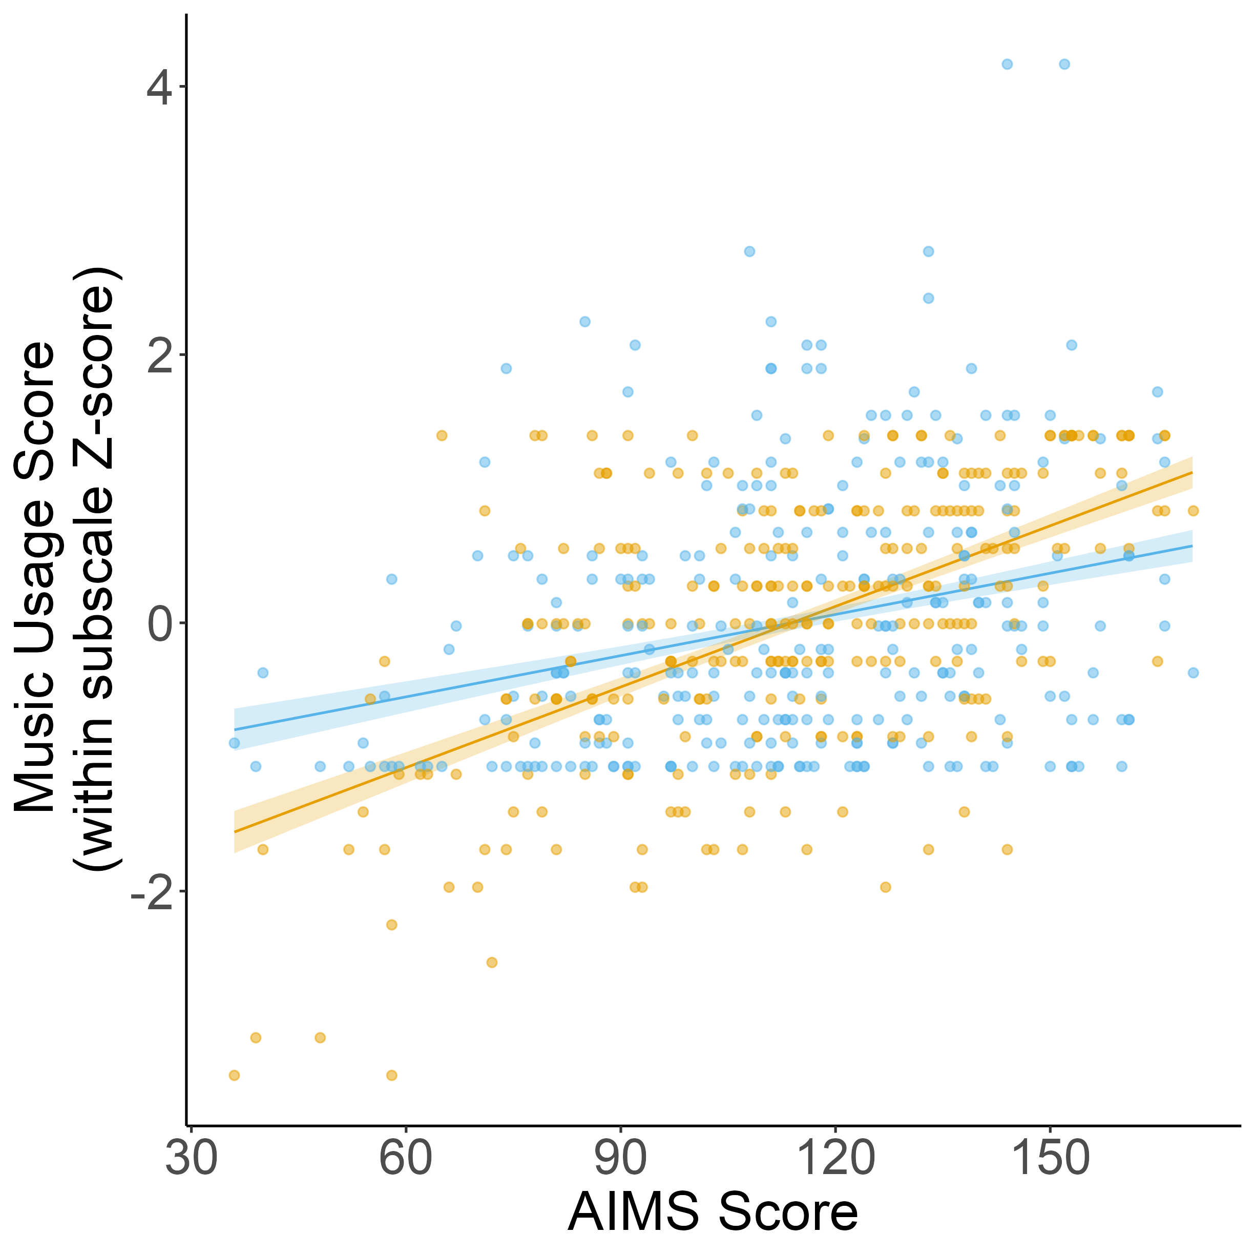
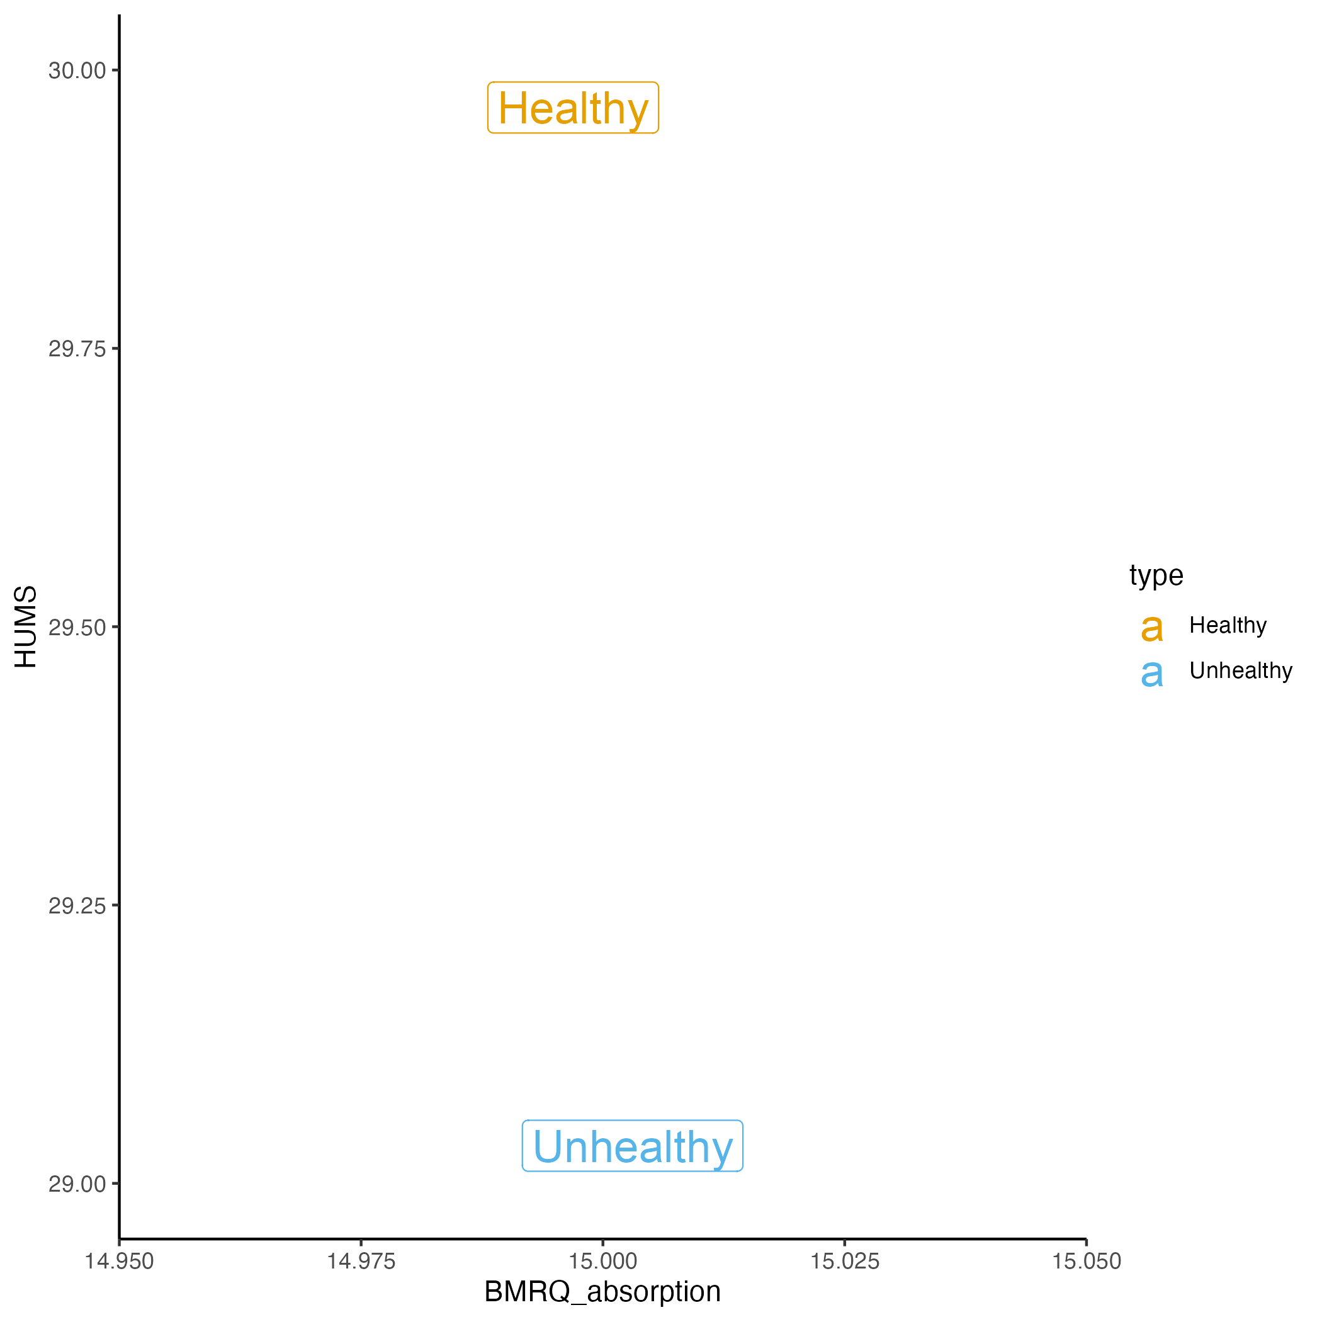
Absorption related to both healthy + unhealthy music usage, but more strongly associated with healthy music usage across both studies
Study 1
Study 2
Notes:
Motivates using absorption over HUMS (and escapism) cause it relates to both
If you absorb more you tend to use music in a more healthy way
Unhealthy though sounds like escapism (simple slopes significant)

Slide 8
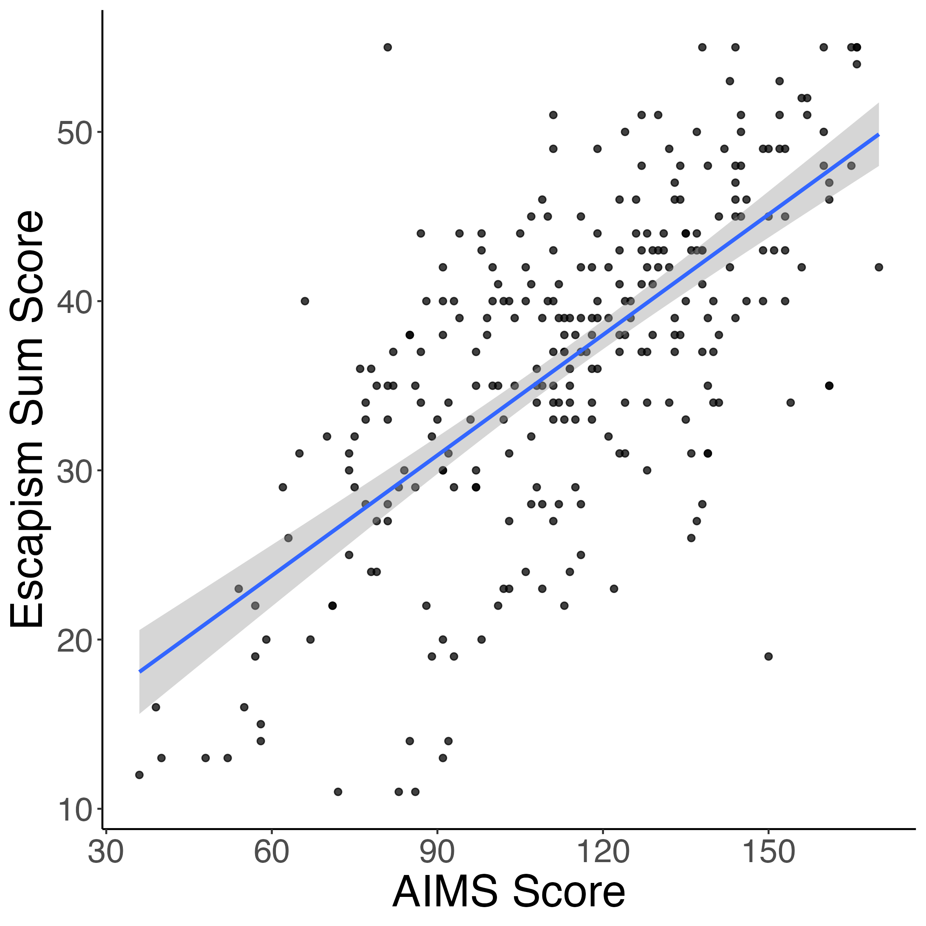
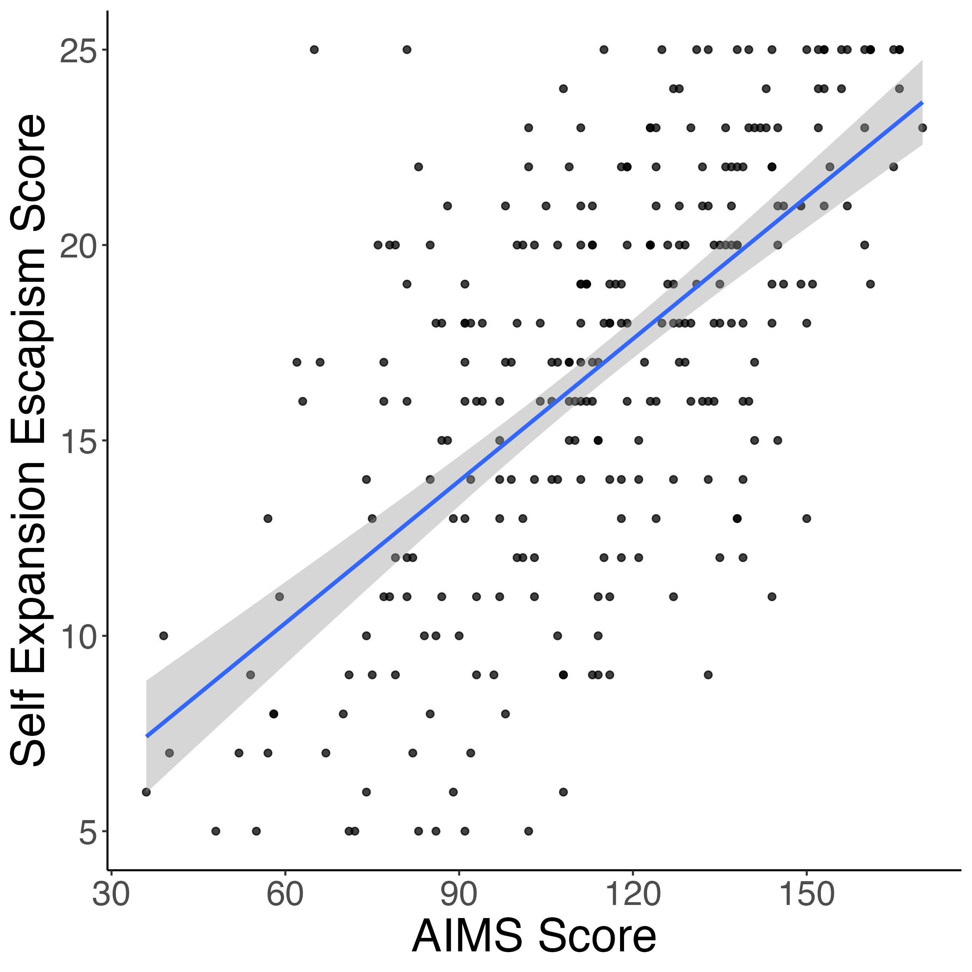
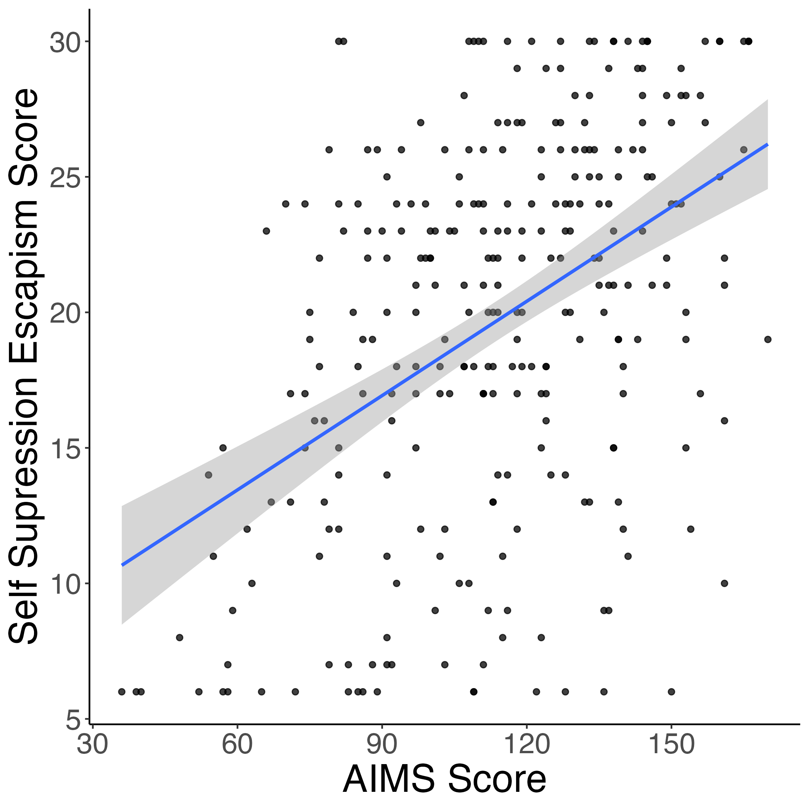
AIMS relates to music usage for escapism
r = 0.68***
r = 0.63***
r = 0.45***

Slide 9
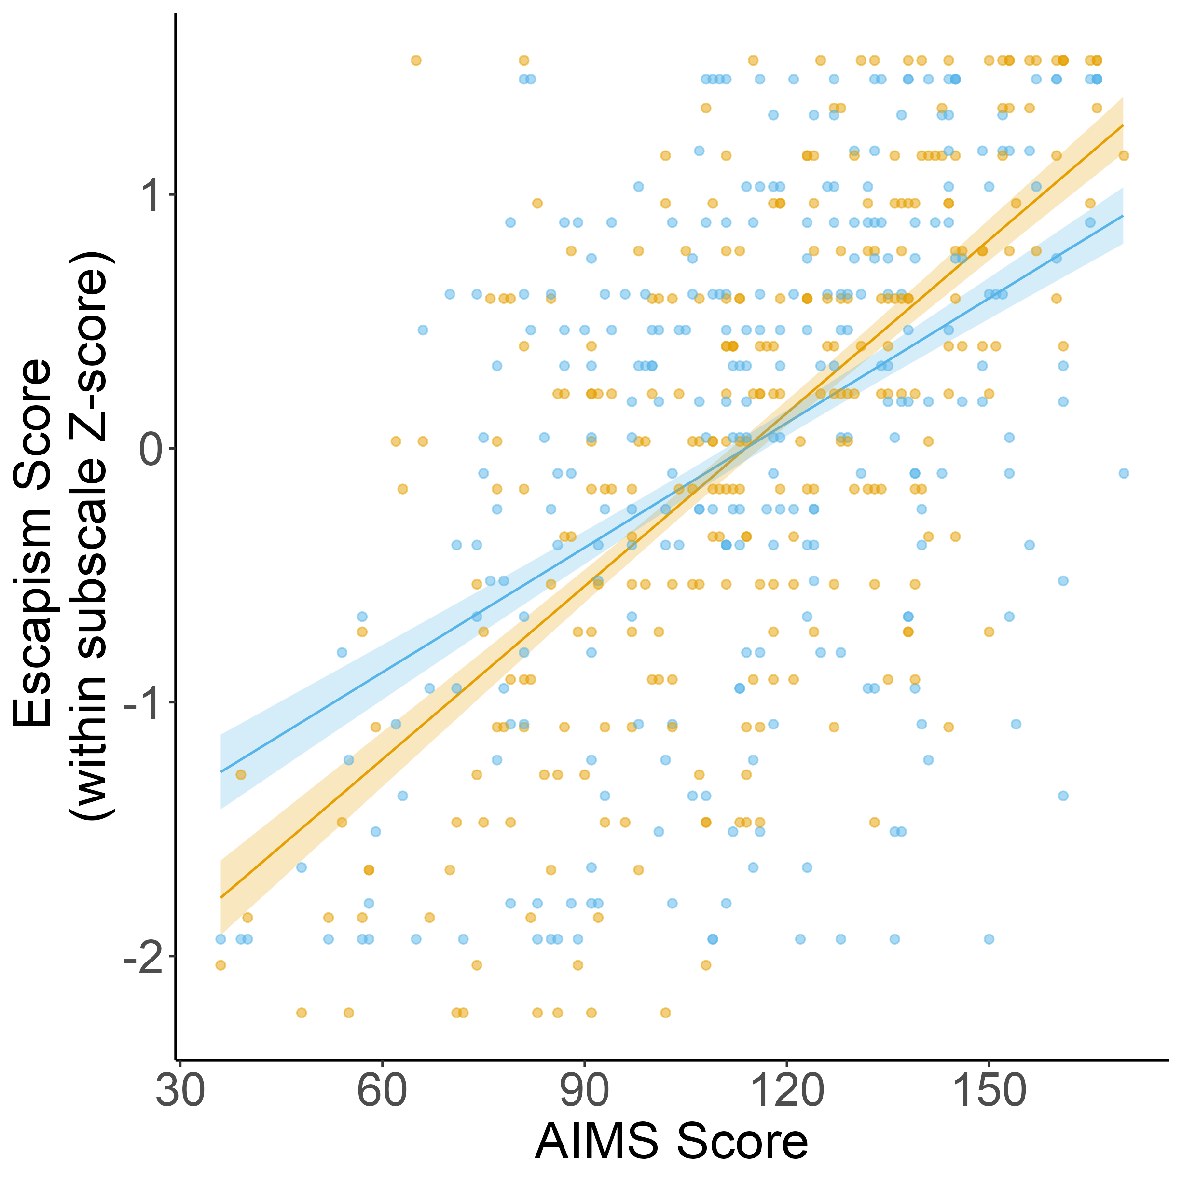
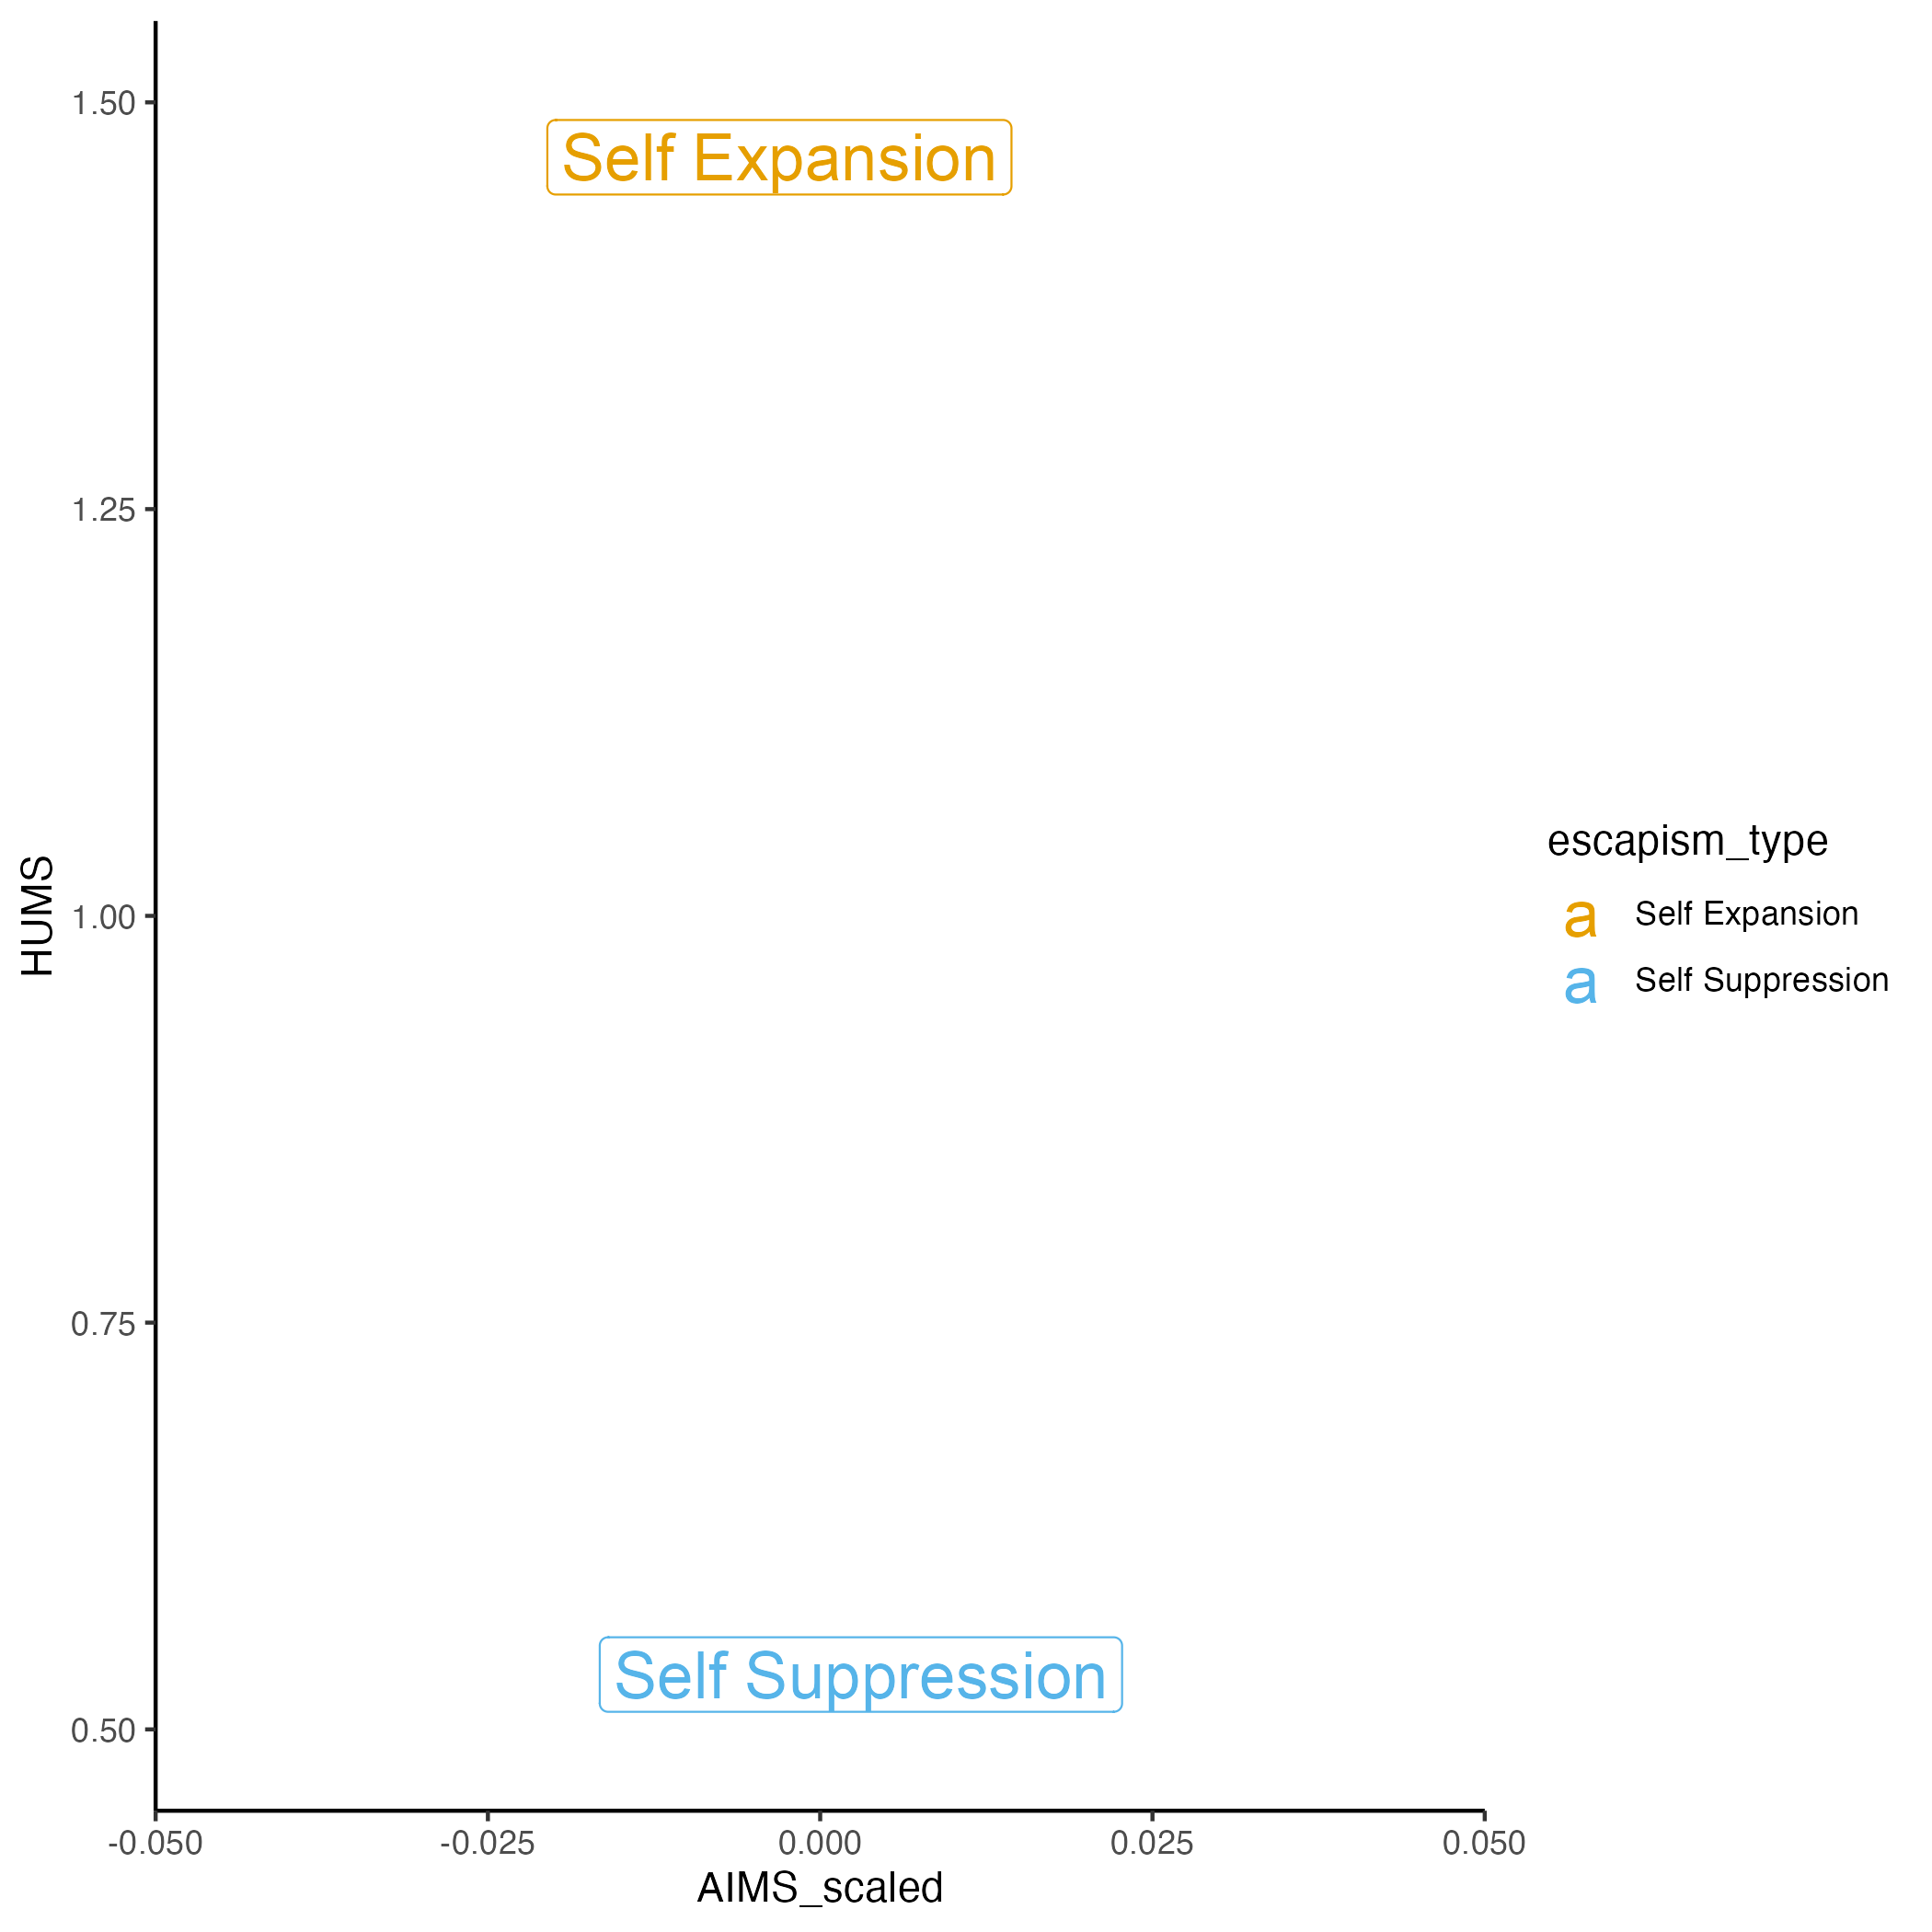
AIMS related more strongly to self expansion than self suppression

Slide 10
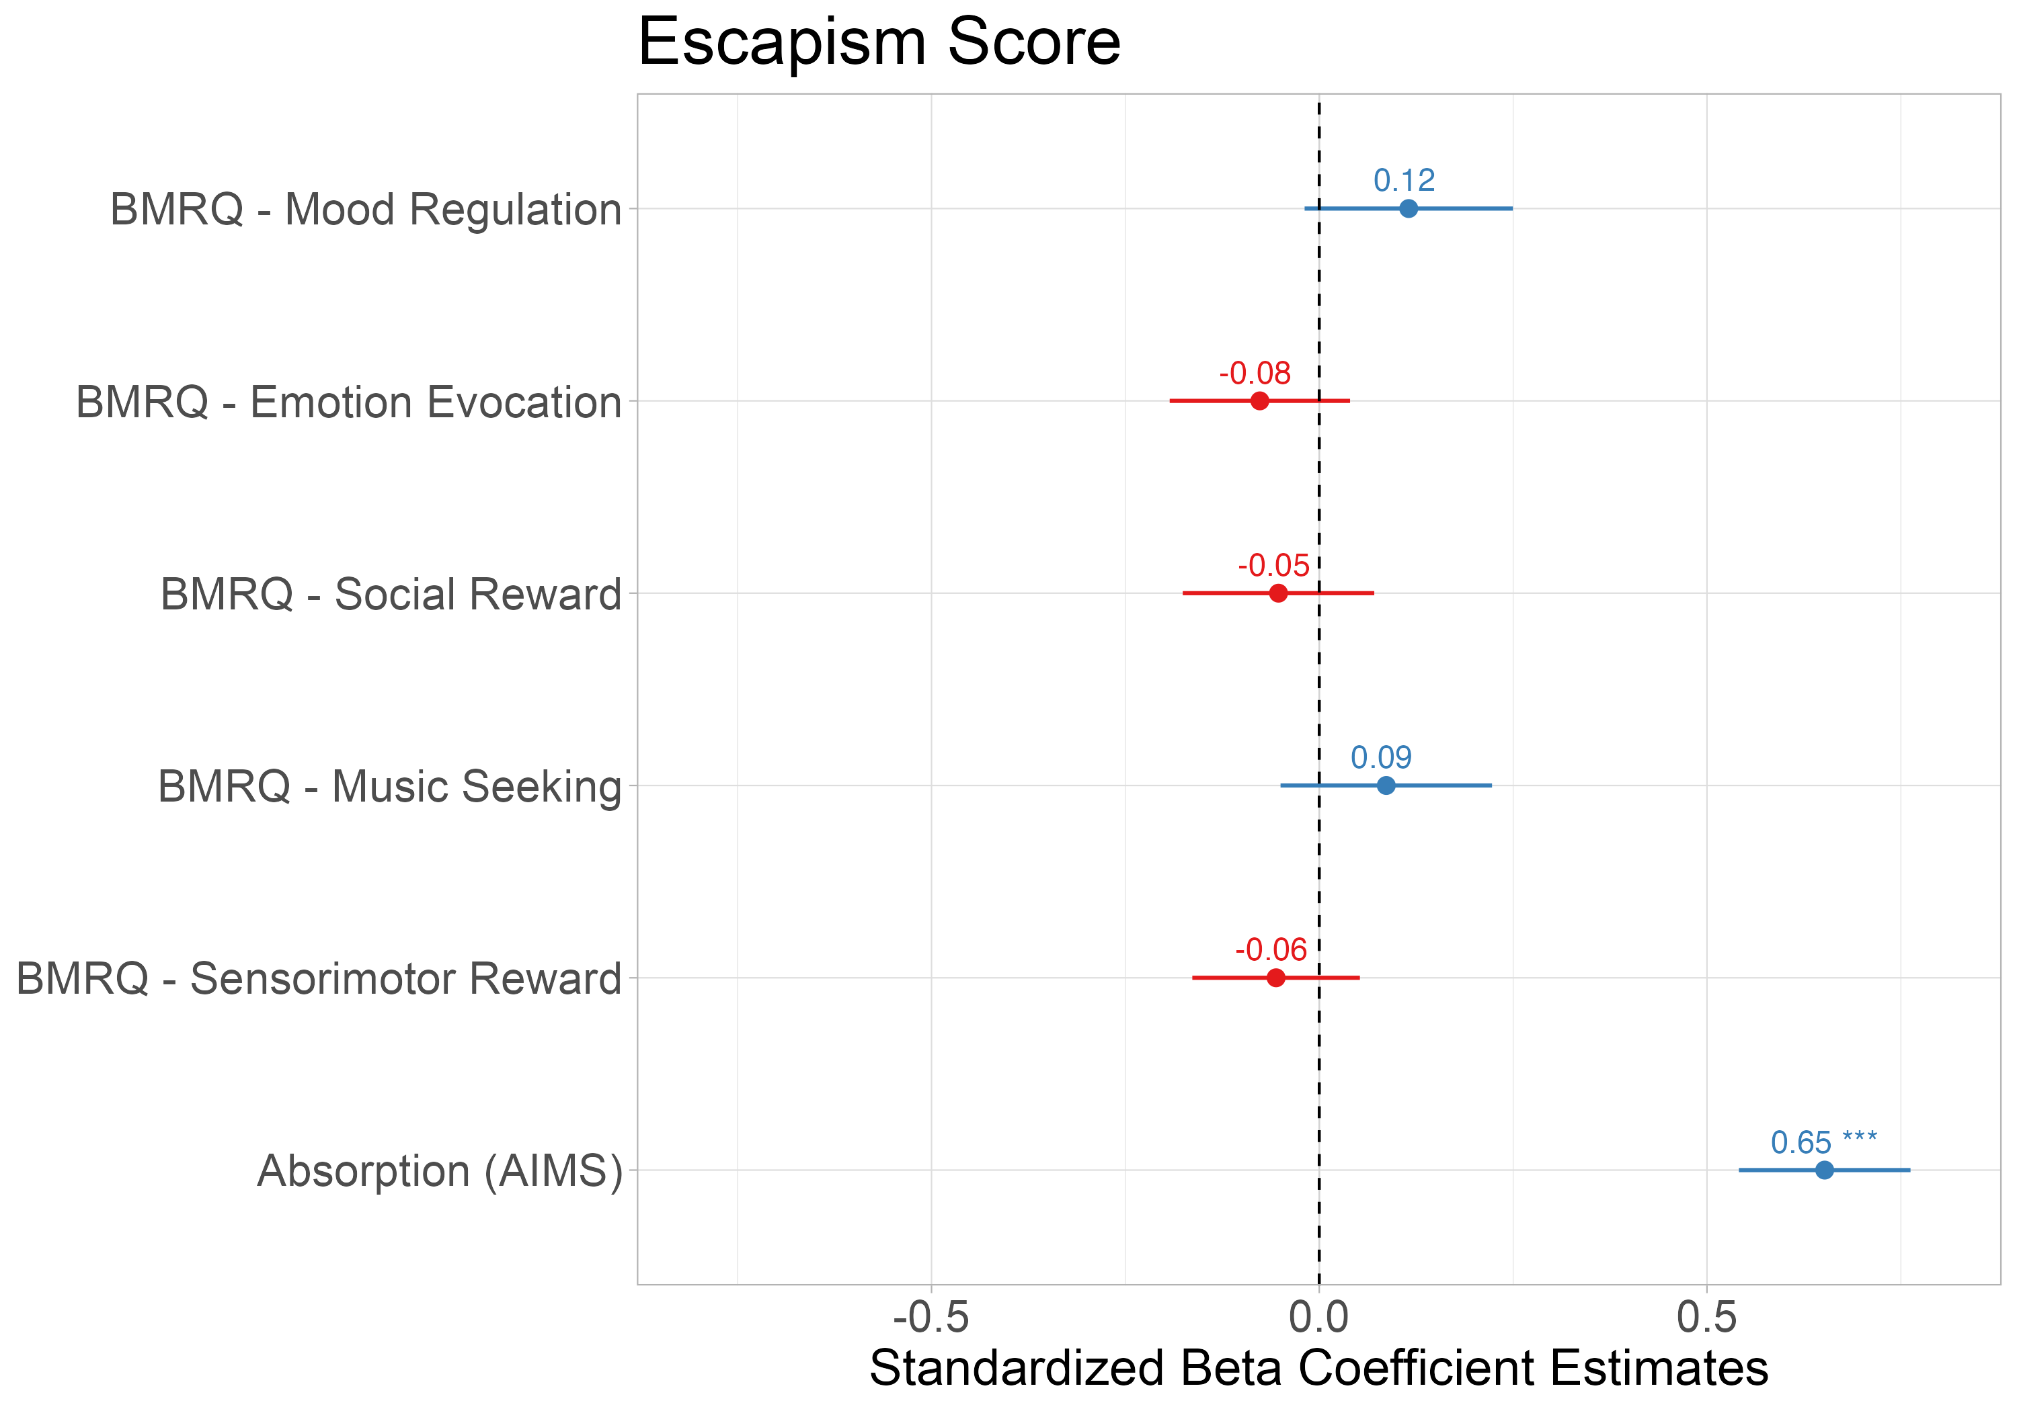
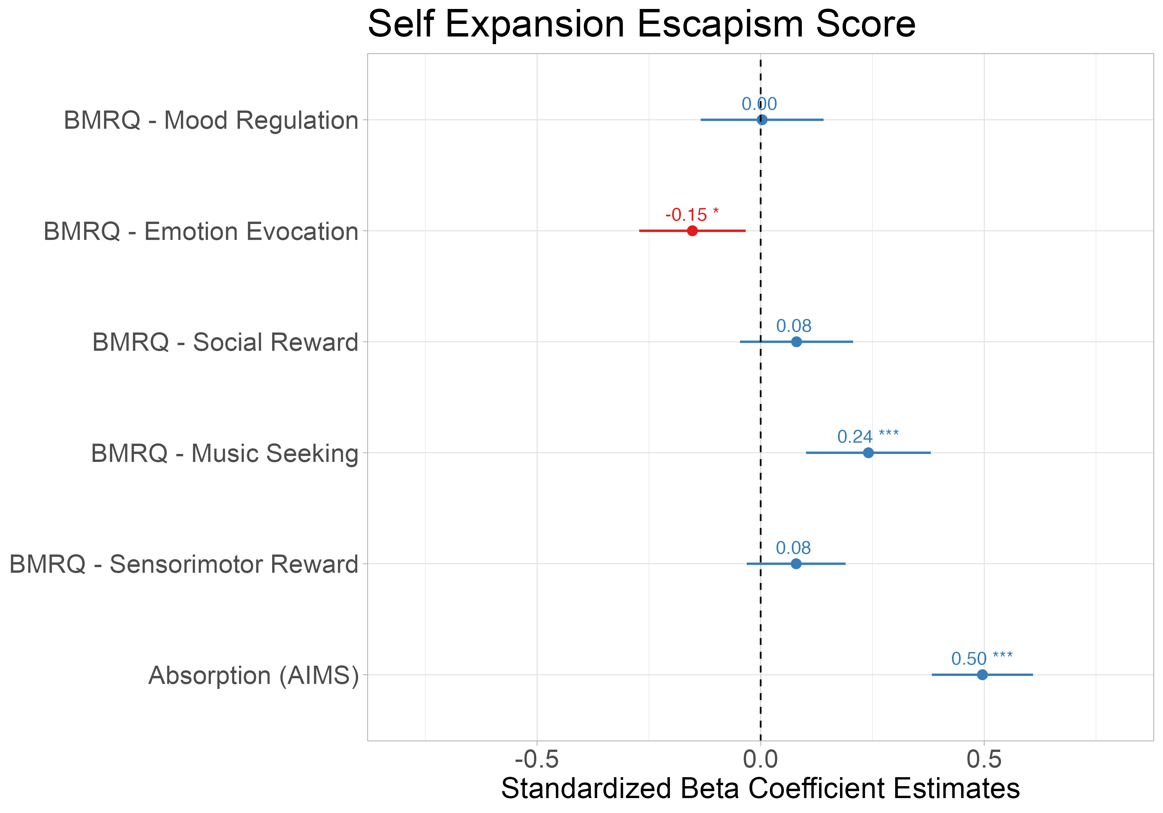
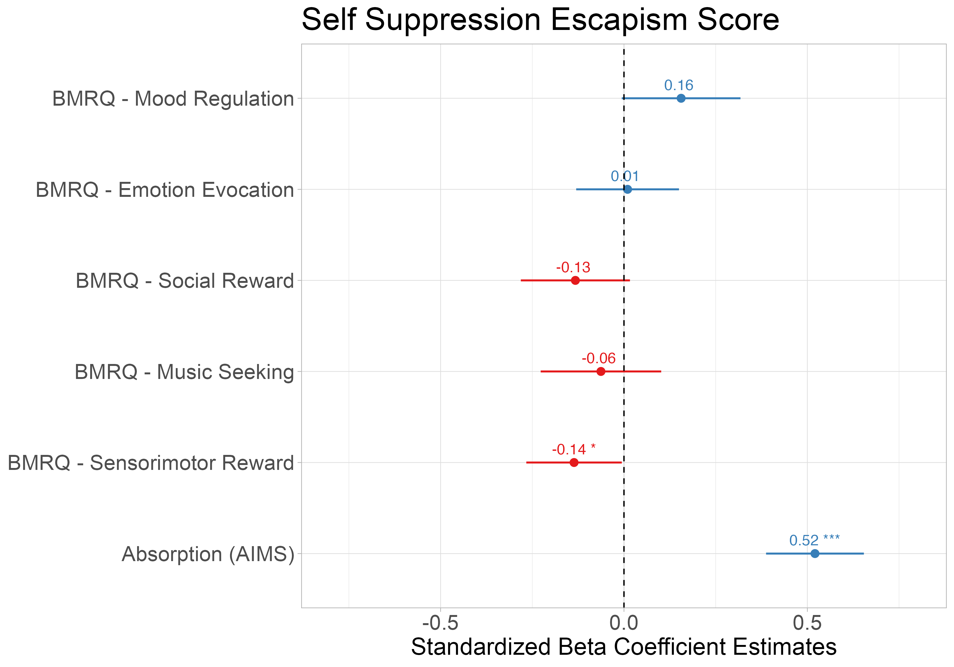
Absorption into music best explains music usage for escapism scores above and beyond other music reward sensitivity measures
Notes:
Music seeking → expansion, more exploration in music perhaps more ways to know one’s self?
Emotion evocation distraction? Or

Slide 11
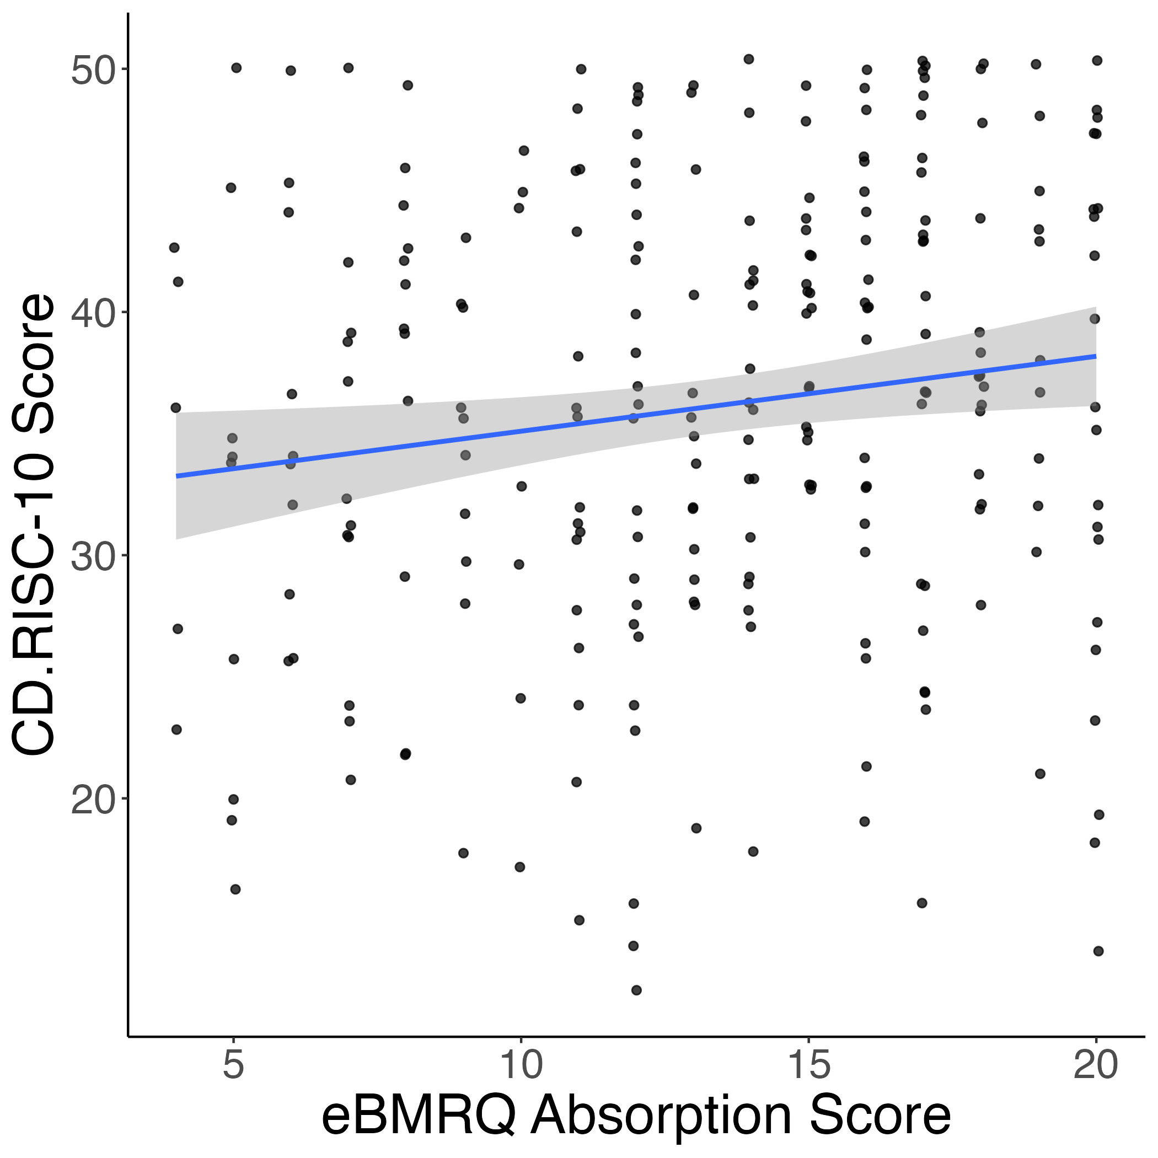
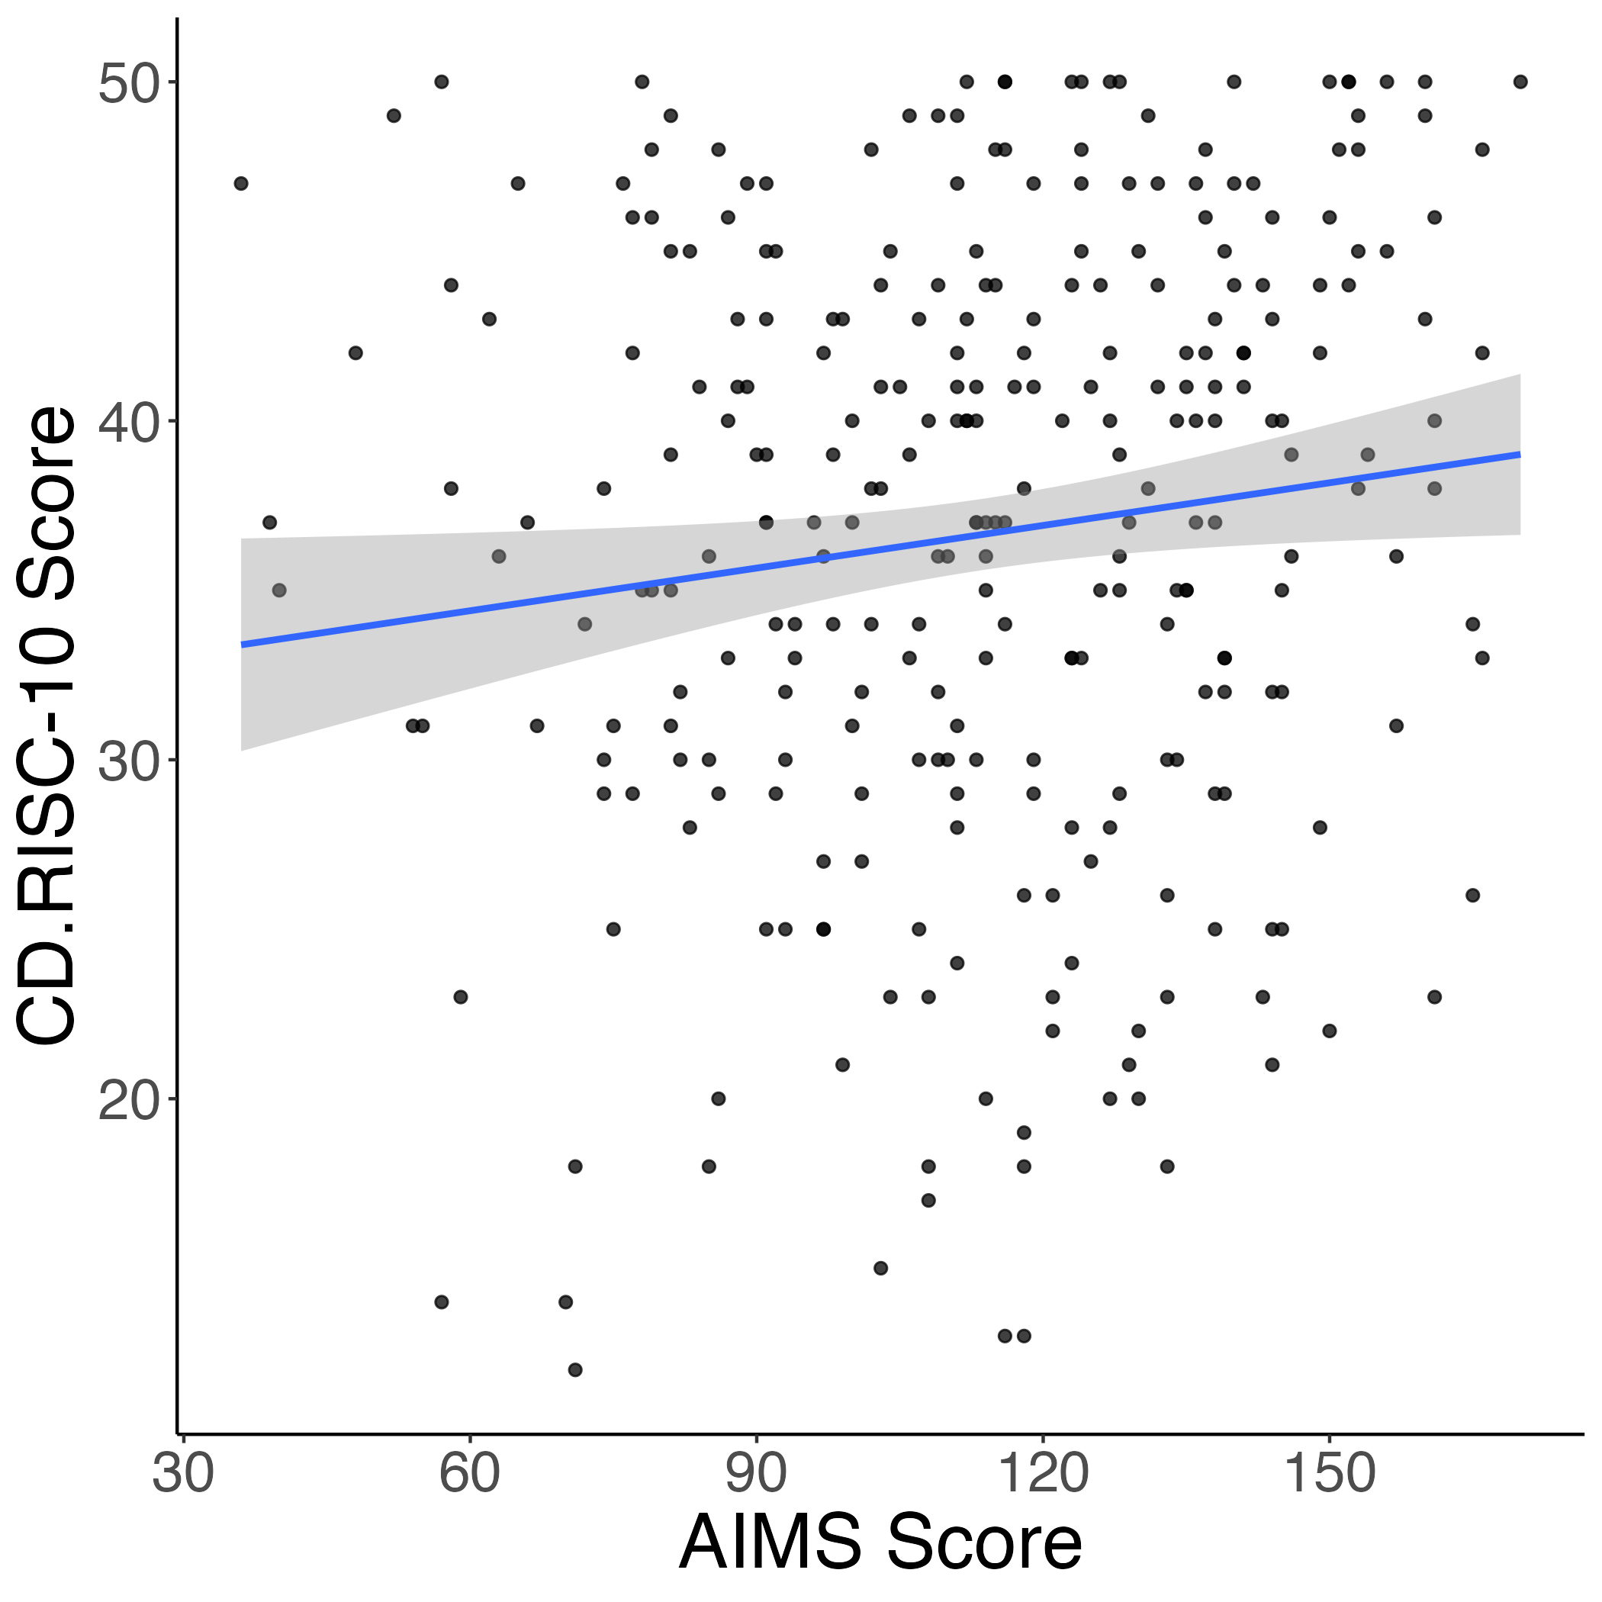
Absorption positively related to resilience
Study 1
Study 2
r = 0.15*
r = 0.13*

Slide 12
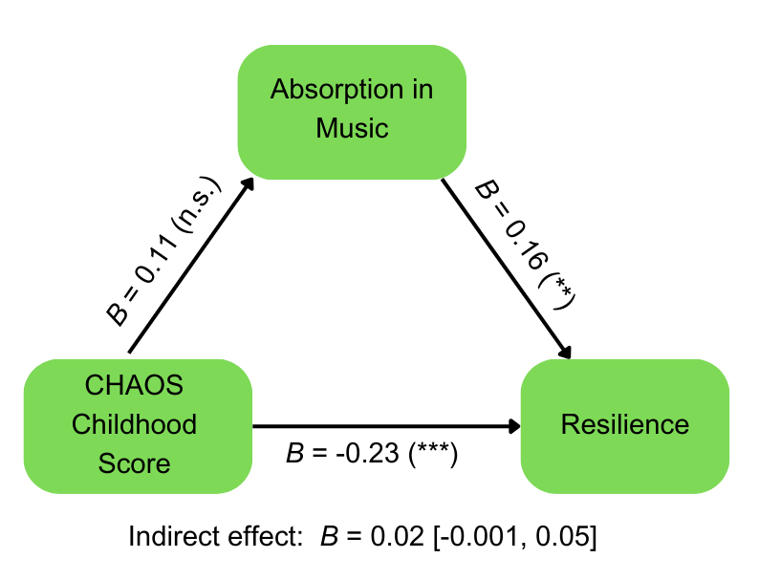
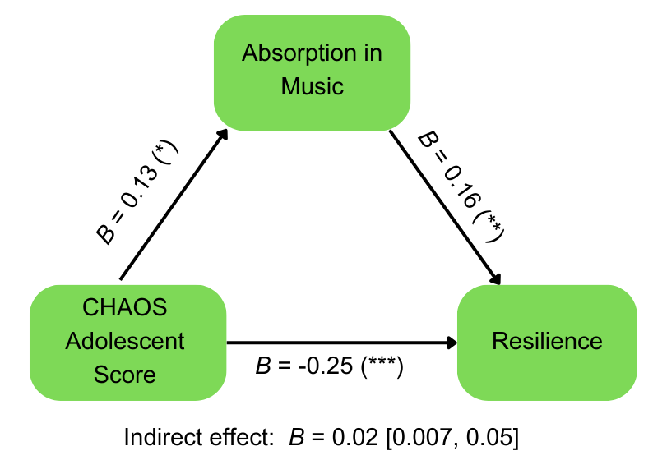
Absorption mediates the relationship between CHAOS and resilience
Notes:
Remains significant with age as covariate
Breakdown in timing follow-up figure
→ ‘flash’ figure following timing breakdown of results

Slide 13
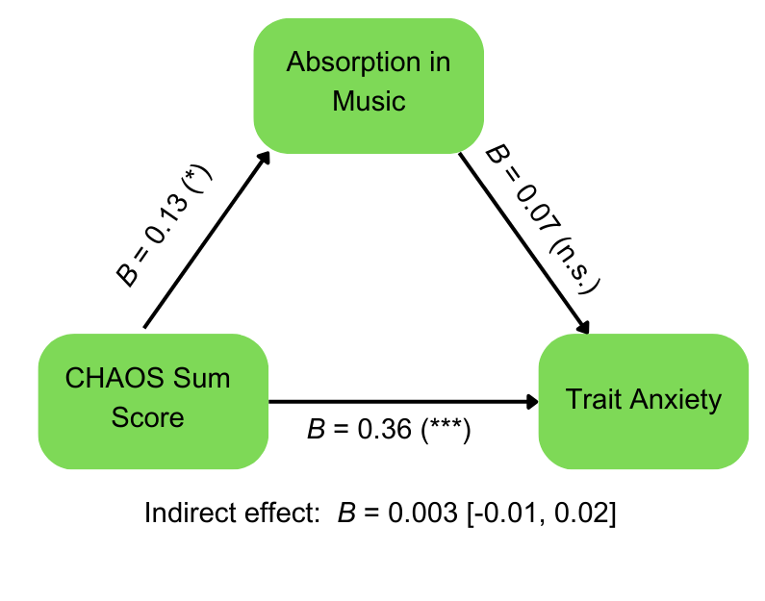
No mediation between CHAOS, AIMS, & STAI

Slide 14
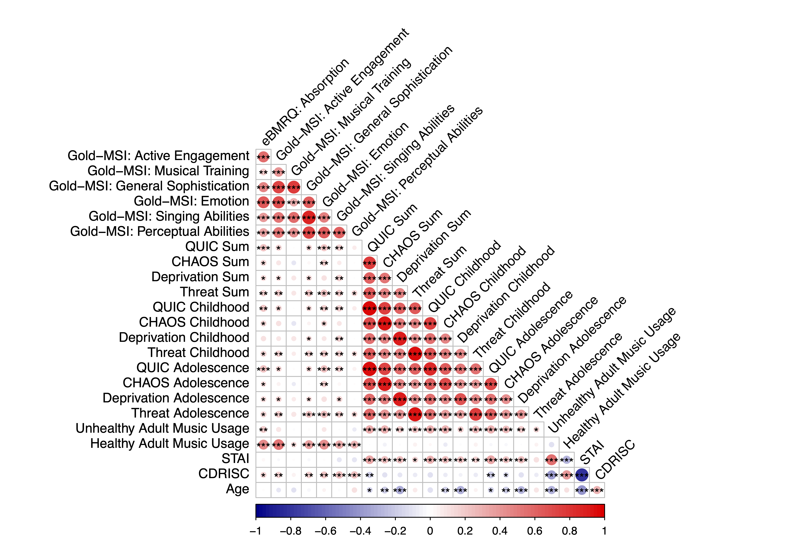
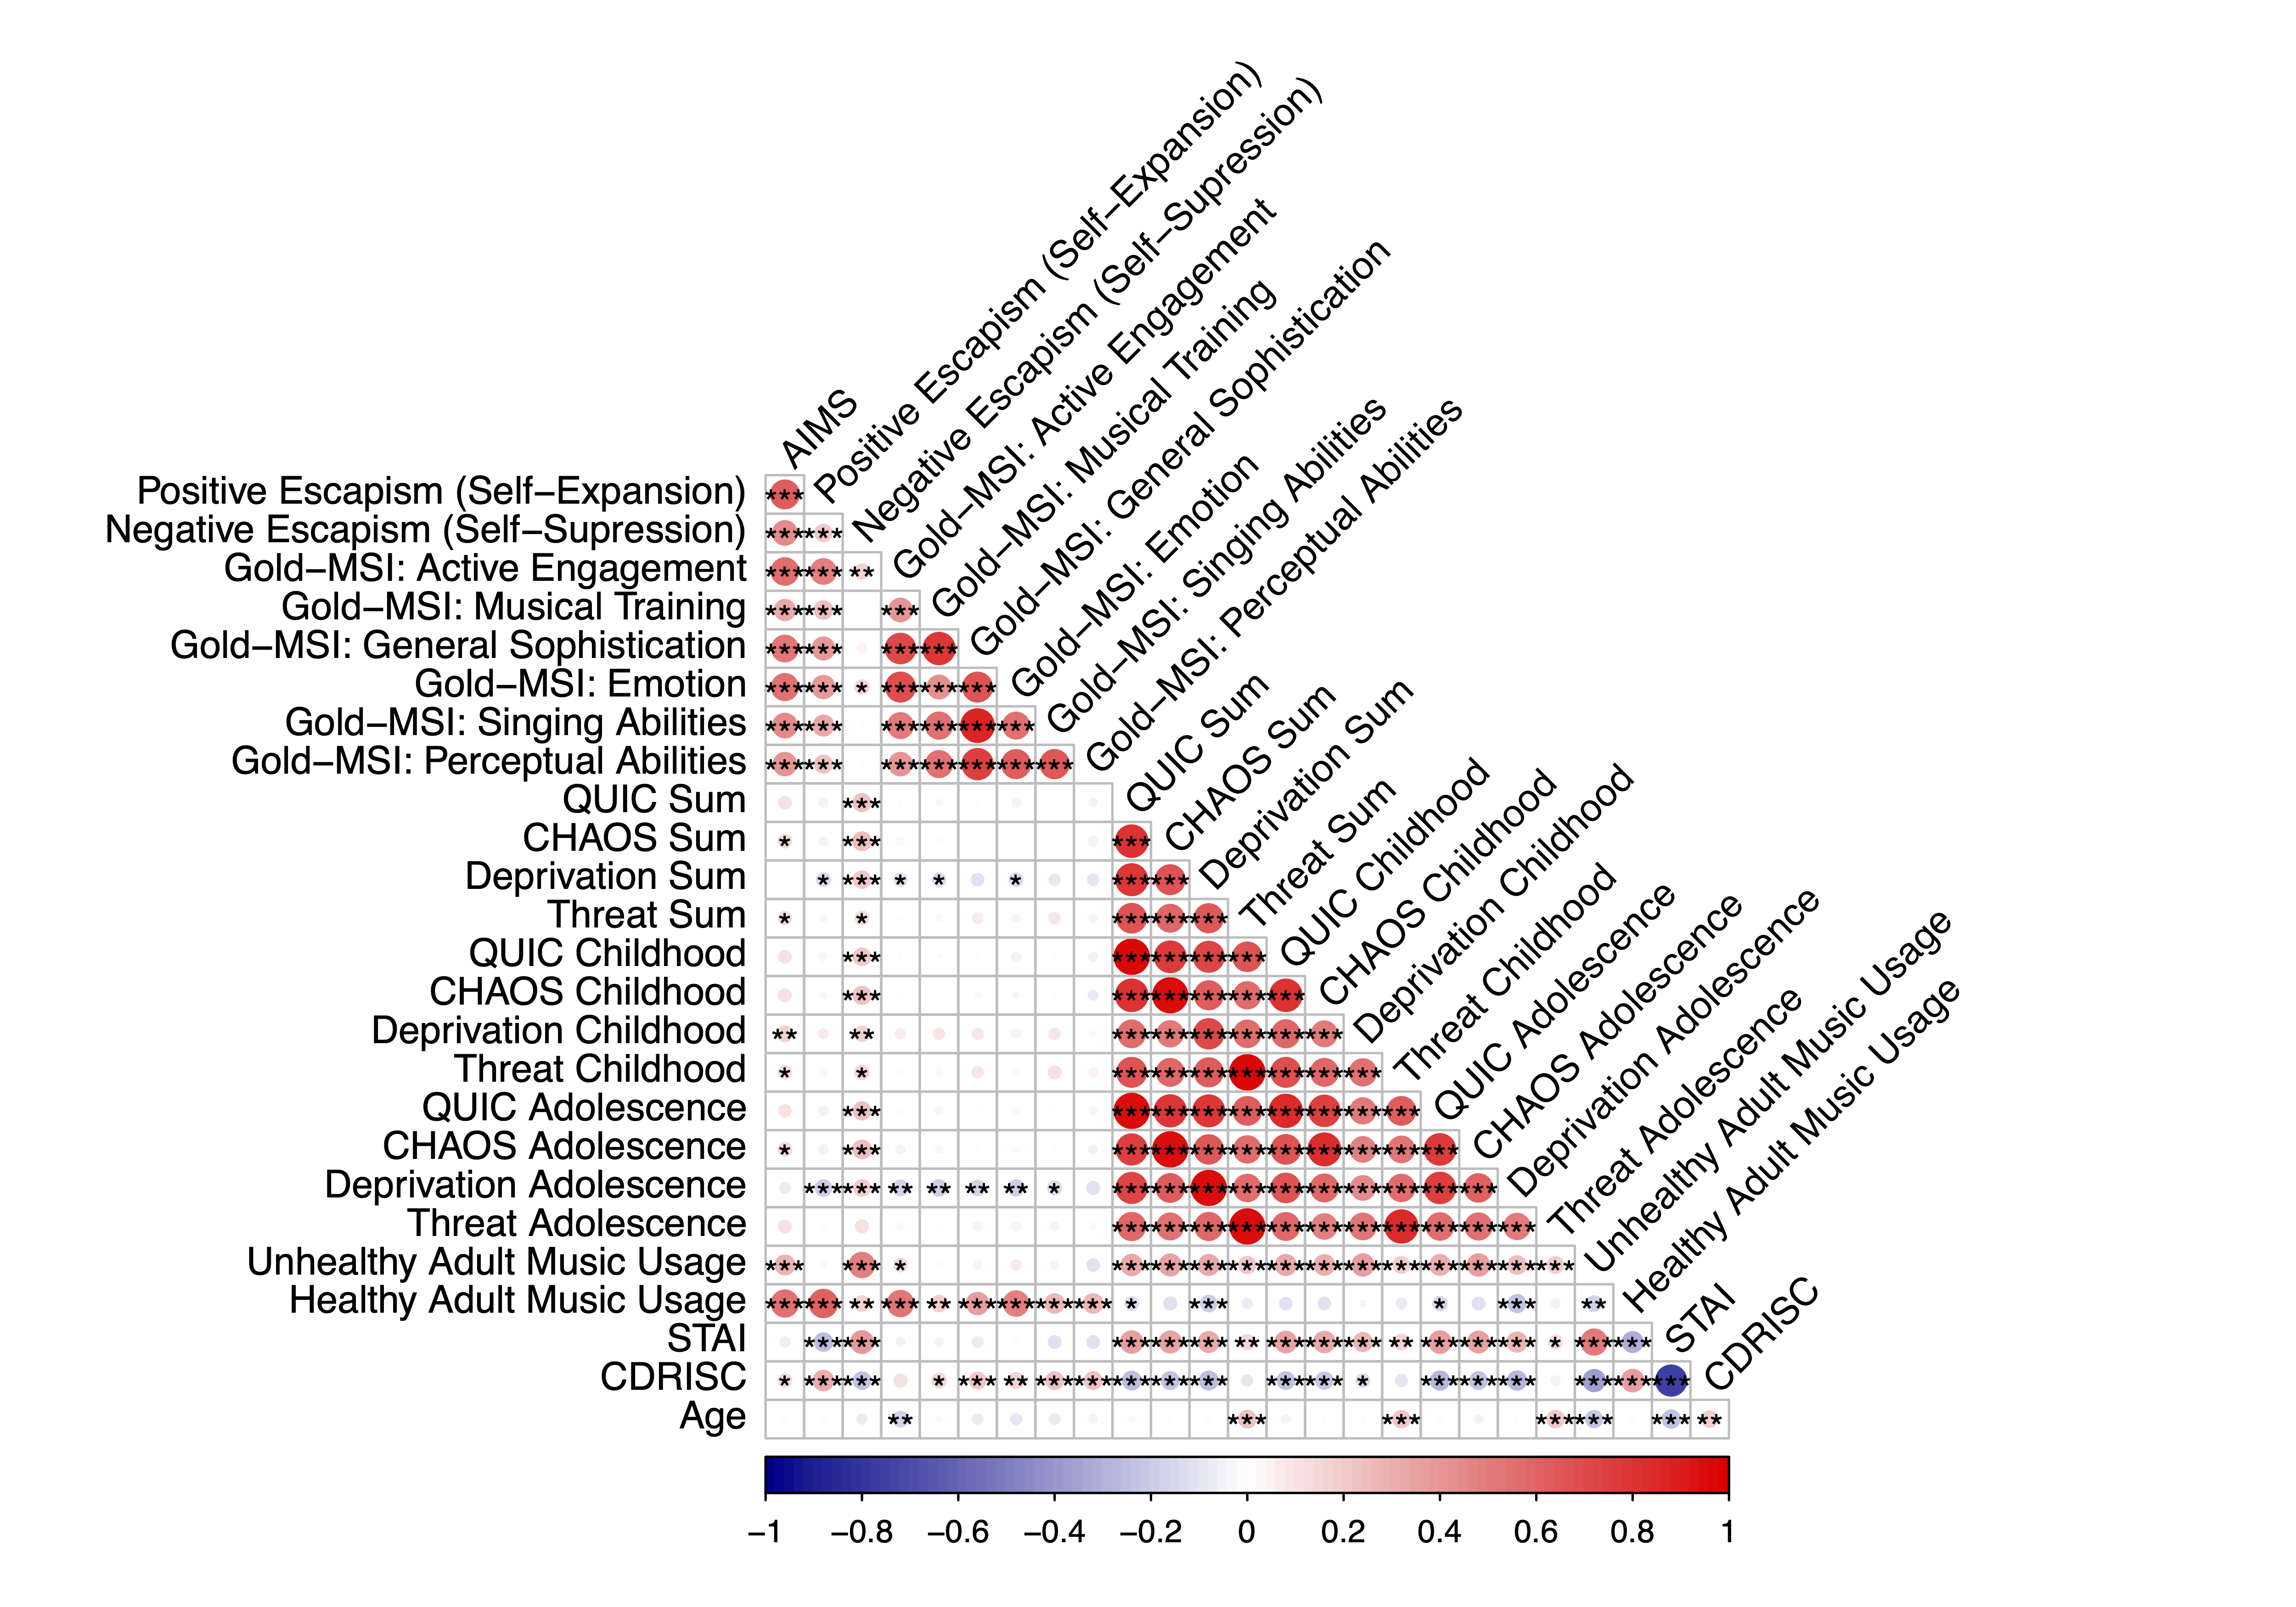
Correlations between goldMSI, AIMS, ELA, STAI, resilience, & age
Study 1
Study 2

Slide 15
*****FIGURES*****

Slide 16
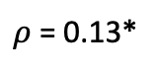
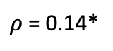
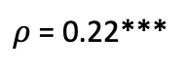
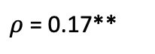
A)
B)
Study 1
$ρ$ = 0.17**
$ρ$ = 0.22***
C)
D)
Study 2
$ρ$ = 0.14*
$ρ$ = 0.13*
Notes:
Switch orientation + add dep

Slide 17
A)
B)
Study 1
r = 0.15*
C)
D)
Study 2
r = 0.13*
Notes:
Motivates using absorption over HUMS (and escapism) cause it relates to both
If you absorb more you tend to use music in a more healthy way
Unhealthy though sounds like escapism (simple slopes significant)

Slide 18
A)
B)
r = 0.68***
C)
D)
E)

Slide 19
A)
B)
Study 1
D)
C)
Study 2
Notes:
Add Study 1 mediation results

